Slide 1
MEDICANES
Sujan Pal
Jimmy Fowler
ATMO 574-FALL 2016

Slide 2
OUTLINE
Climatology
Medicane 90M
  Observations and impacts
  Tropical vs Extratropical vs Subtropical
Analysis of 90M
  GFS analysis throughout life cycle
  QG analysis

Slide 3
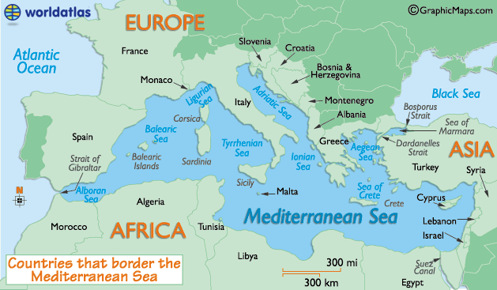
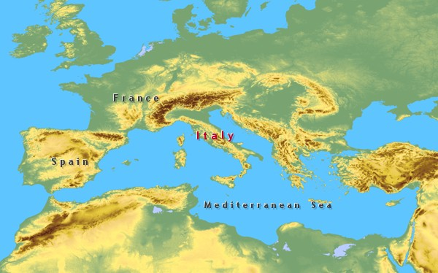
Climatology
Geography and topography around Mediterranean Sea

Slide 4
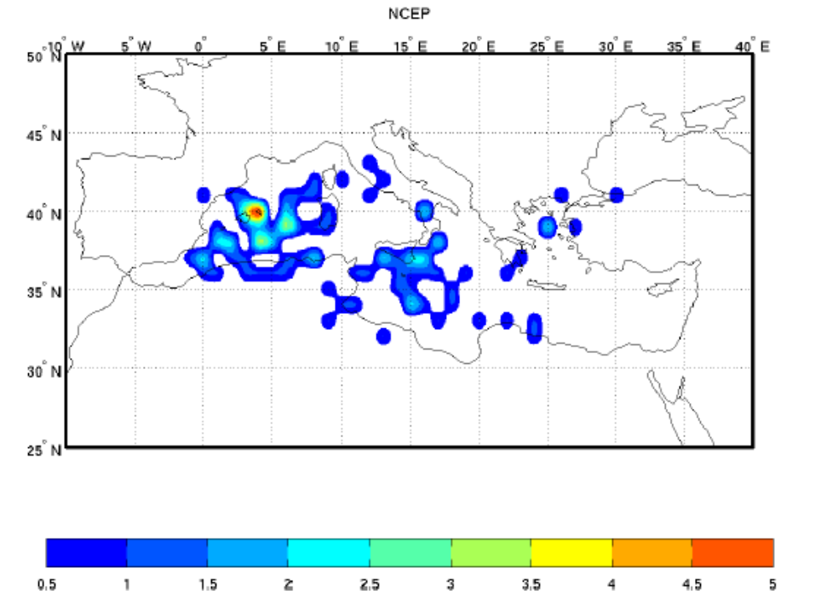
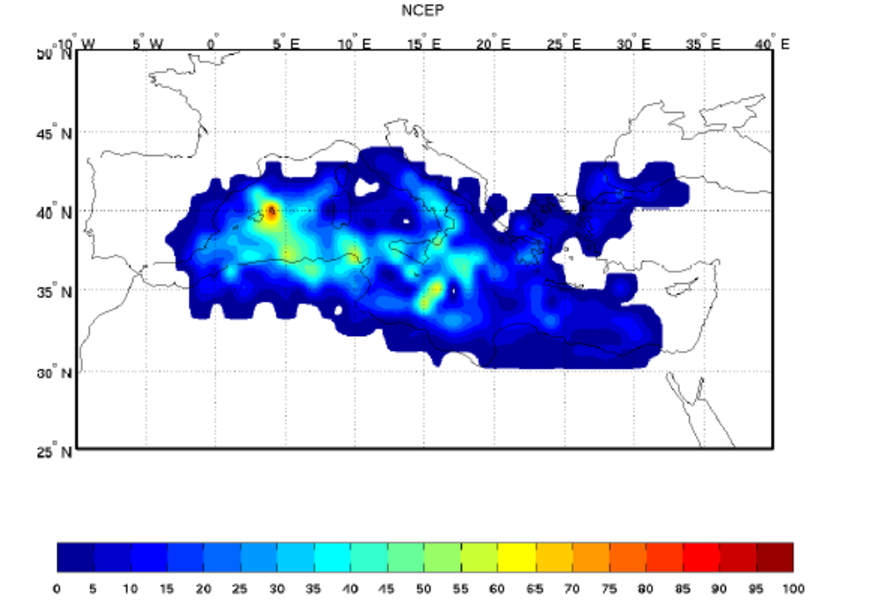
Climatology
Genesis Density ( First location in the track) per 2^{O} x 2^{O} box
Track density per 2º x 2º box

Slide 5
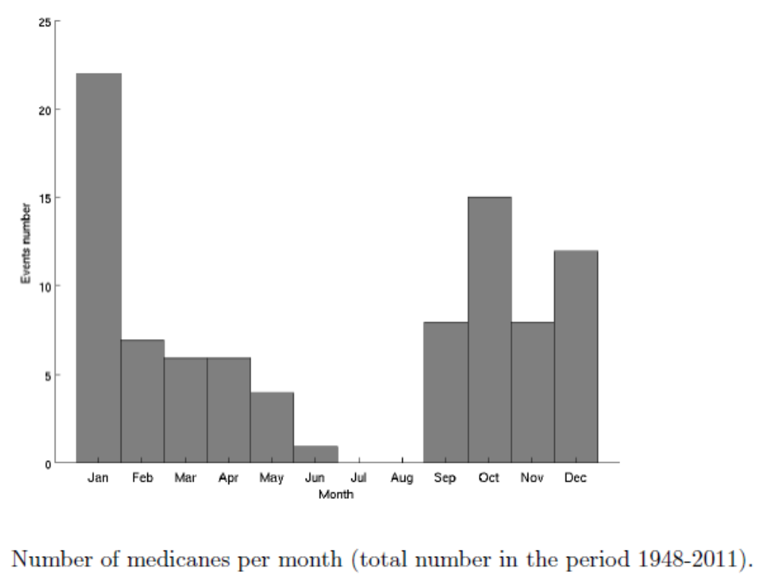
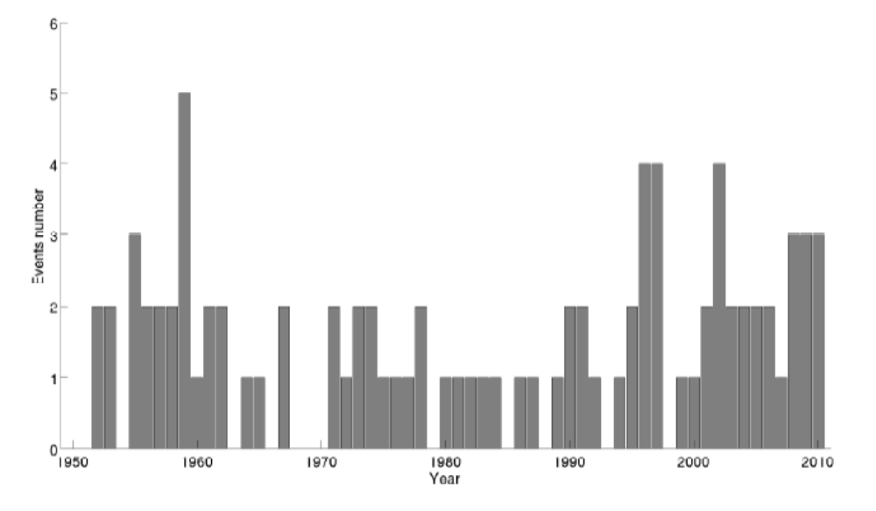
Climatology
Number of medicanes per season

Slide 6
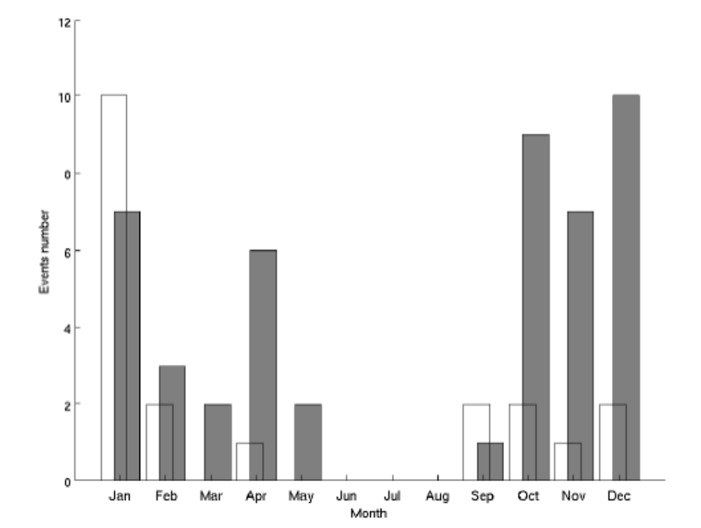
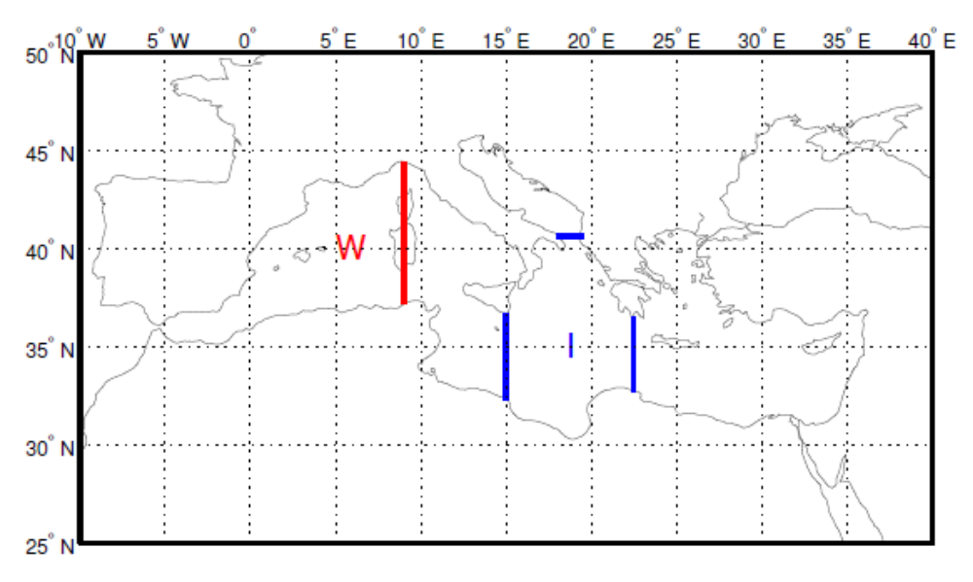
Climatology
Western Mediterranean ( W) and Ionian region (I)
Number of medicanes per month, grey: W, white: I

Slide 7
Climatology : Overview
Low wind shear and atmospheric thermodynamic instability induced by incursions of cold air
Upper-level troughs, providing energy required for intensifying atmospheric convection/thunderstorm
Known to emerge over regions with sea surface temperatures (SSTs) between 15º C and 26 °C
Tropical cyclones with a diameter larger than 300 km (190 mi) cannot exist within the Mediterranean
99 recorded tropical-like storms between 1948 and 2011.

Slide 8
Medicane 90M

Slide 9

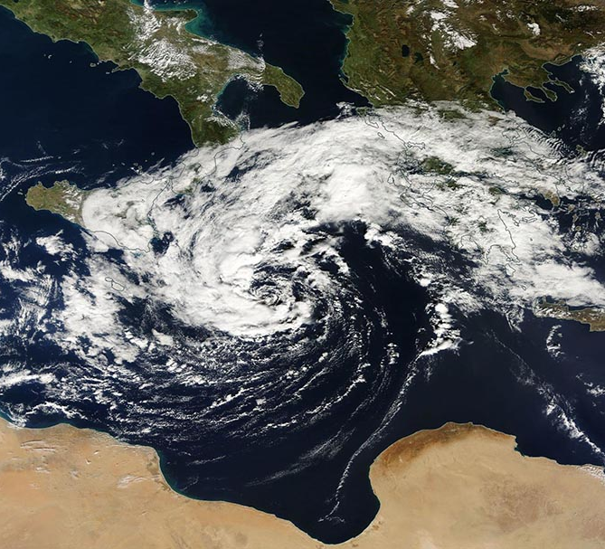
Medicane 90M
A cutoff low triggered a tropical storm to form over the Mediterranean Sea over Halloween weekend
It reached peak intensity of 50 kts on 10/31
Biggest impacts happened on the island of Crete
  City of Chania, Crete recorded 3.07” of rain and wind gust of up to 60 mph
    Average precipitation for all of October is 1.6”
  Heraklion, Crete received .71 inches of rain
Rough ocean in Malta
Visible satellite image of the medicane on October 30th (Wunderground)

Slide 10
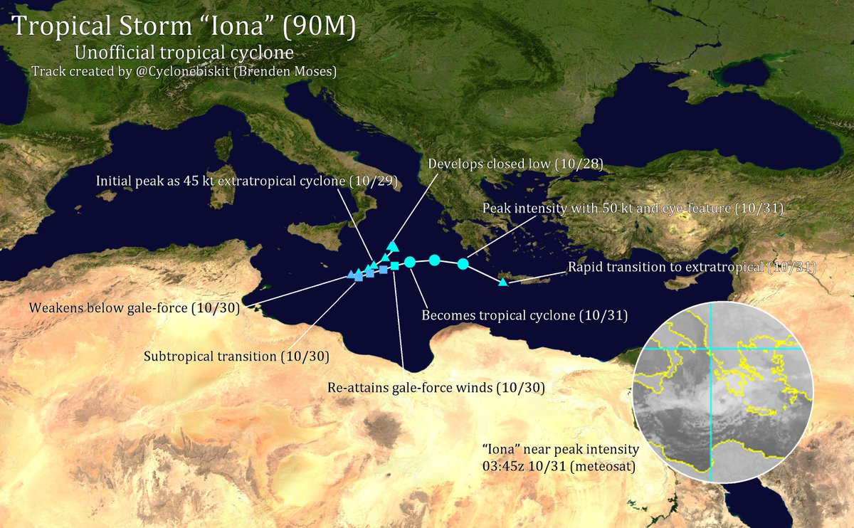
Storm Track
Source: Twitter user Brenden Moses

Slide 11
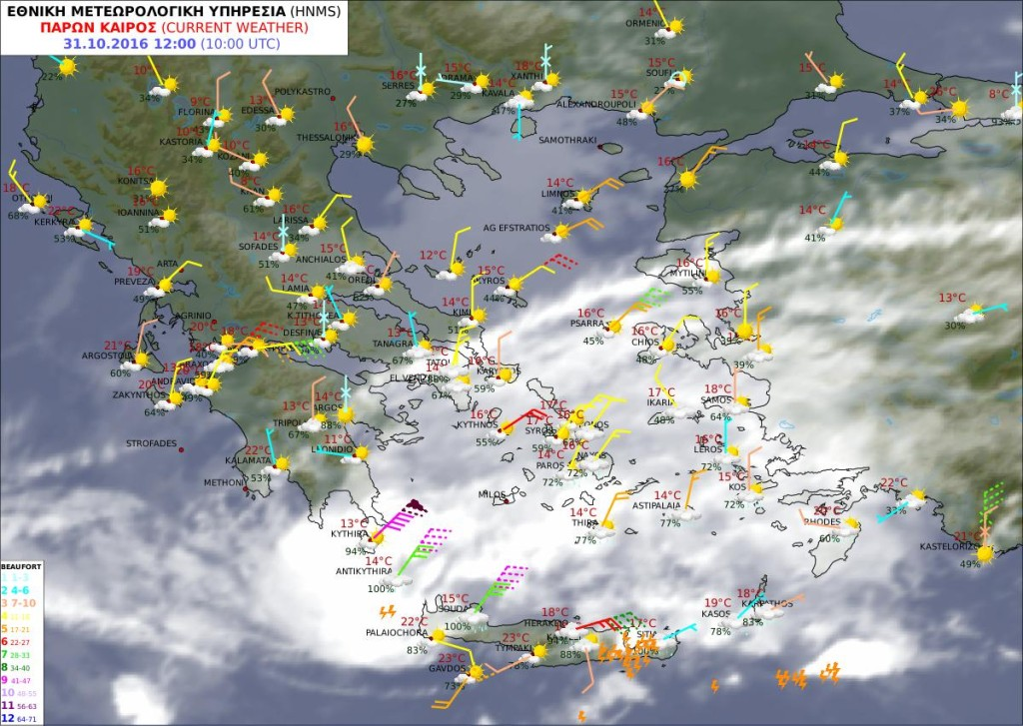
Observations
Source: http://www.hnms.gr/

Slide 12
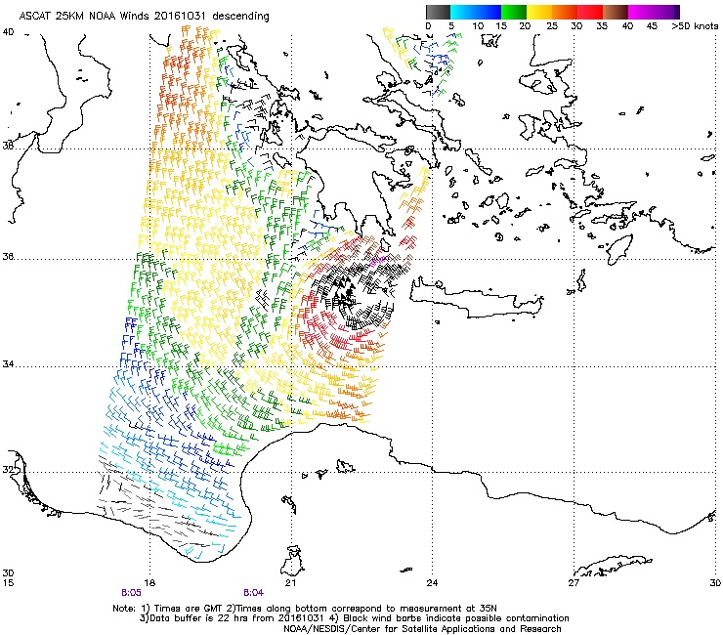
Observations
Wind speed derived from the European Advanced Scatterometer (ASCAT) show speeds around 50 knots on the western edge of the eye of the medicane as it approached Crete
Source: Wunderground

Slide 13
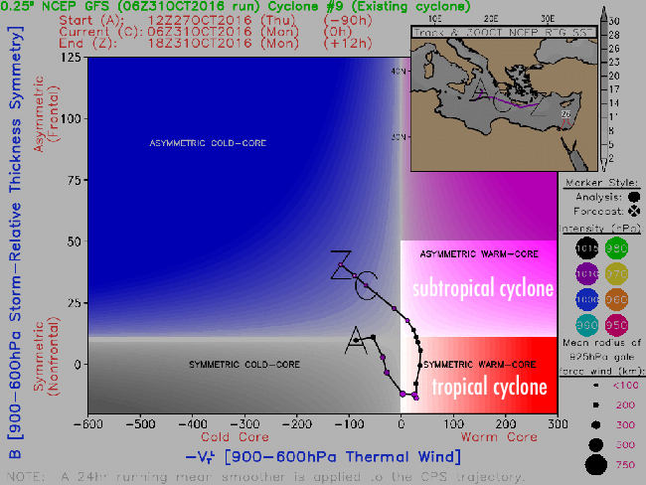
Tropical Transition
Lifecycle of 90M:
  Started out as a symmetric cold core cyclone (cutoff low) from the 27th through 12z on the 28th
  Became a symmetric warm-core cyclone from 18z on the 28th till the 30th at 0z
  90M then entered a subtropical phase till 31st
Source: Florida State University

Slide 14
Tropical vs Subtropical vs Extratropical
Extratropical: A cyclone that gets energy from a horizontal temperature contrast (baroclinic). There are surface fronts and has a cold core.
Tropical: A cyclone that gets energy from warm ocean waters and has organized deep convection around a well defined center. They are barotropic with a warm core.
Subtropical: A mixture of both extratropical and tropical cyclones. They do not have surface fronts, but receive a portion of their energy from baroclinic sources.
Source: National Hurricane Center Glossary

Slide 15
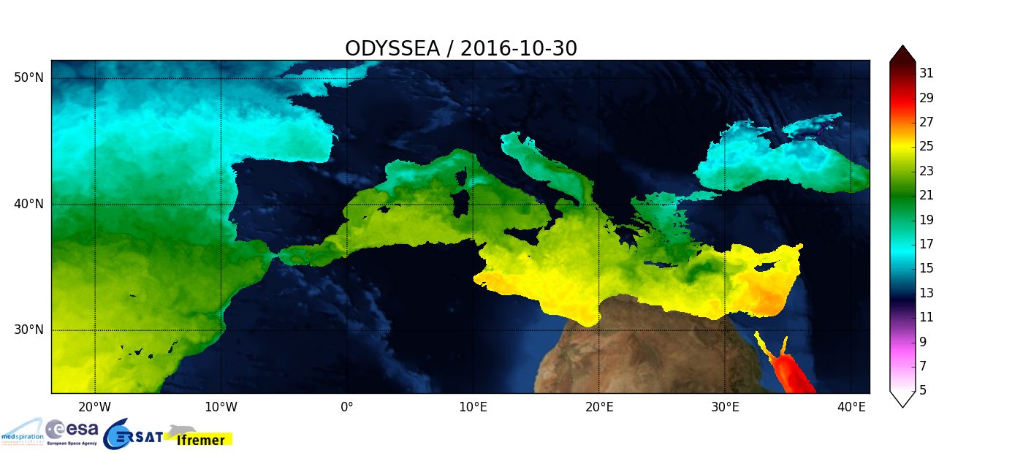
Very Warm SSTs
Source: CERSAT
Notes:
SSTs from 23-25C, average is ~20-21

Slide 16
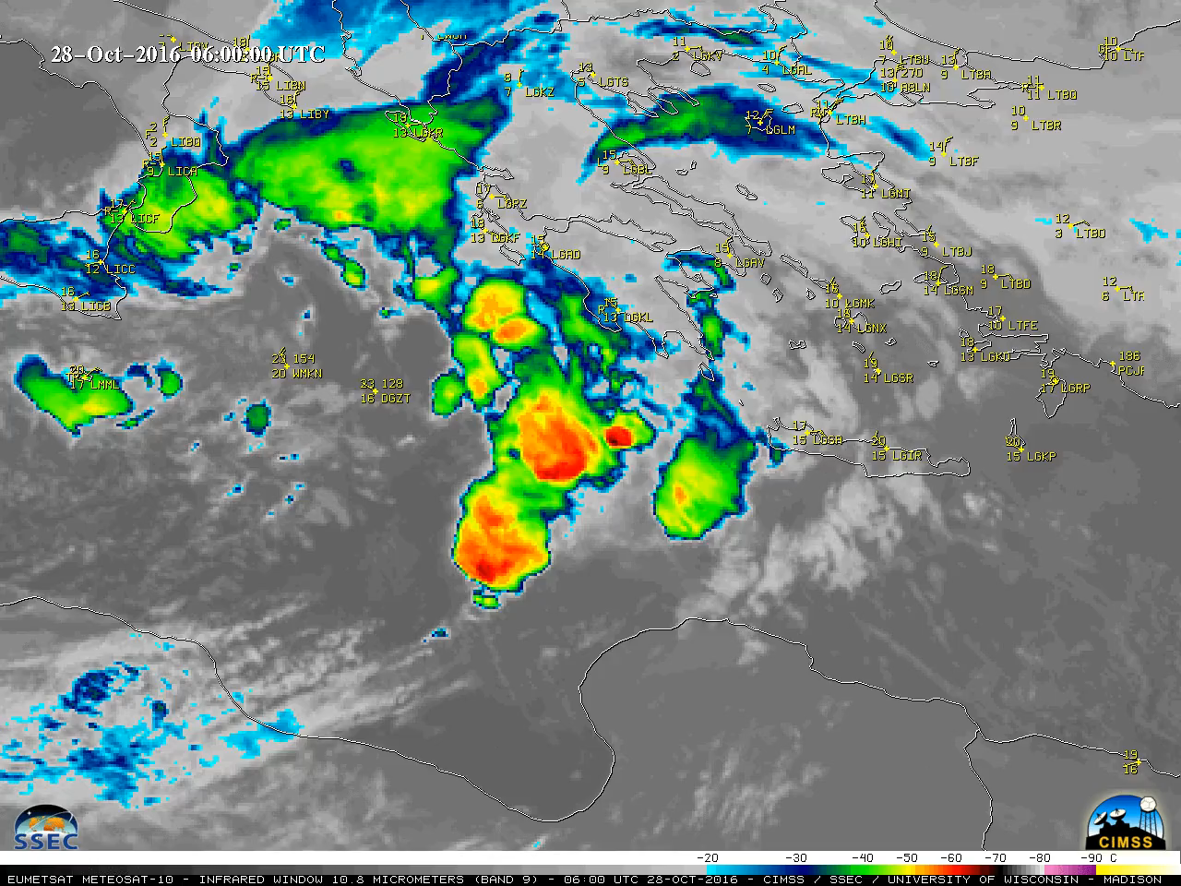
IR Loop
Source: CIMSS

Slide 17
Map Analysis

Slide 18
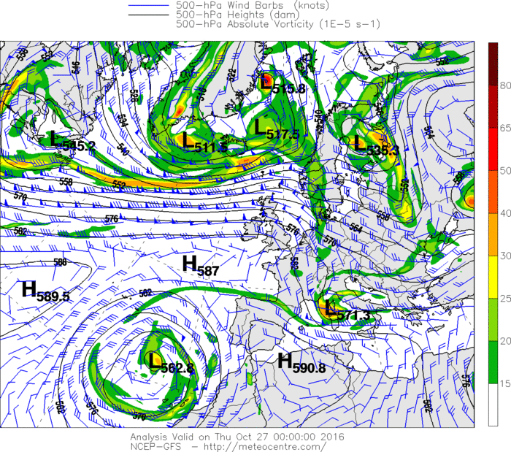
10/27 0z
A cutoff upper-level low begins to move SE over the western Mediterranean Sea

Slide 19
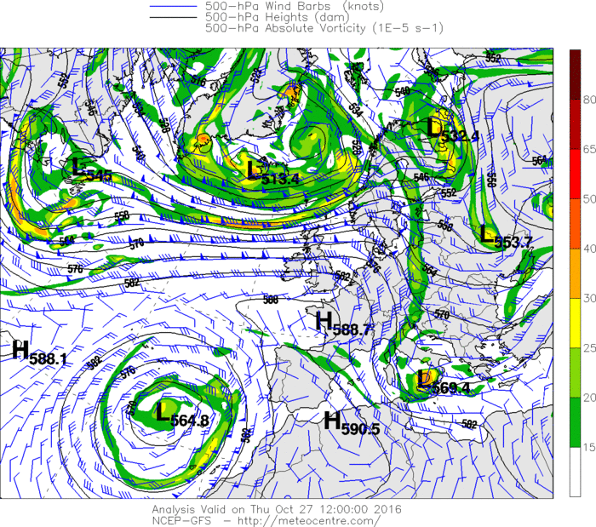
10/27 12z
The low moves SE towards Sicily

Slide 20
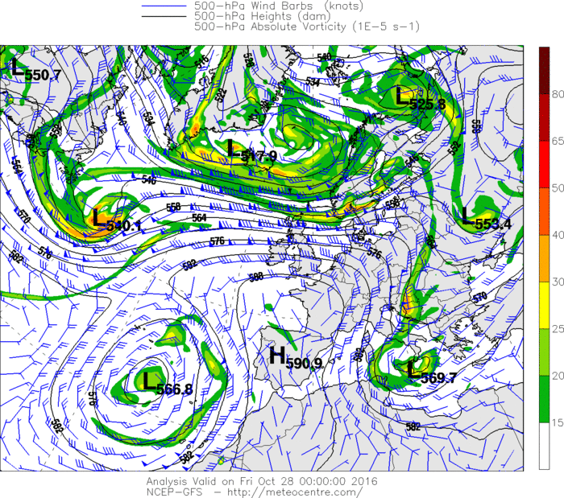
10/28 0z
The low begins to meander over the center Mediterranean Sea
The high over Spain appears to be the main steering force
The Omega block across SW Europe

Slide 21
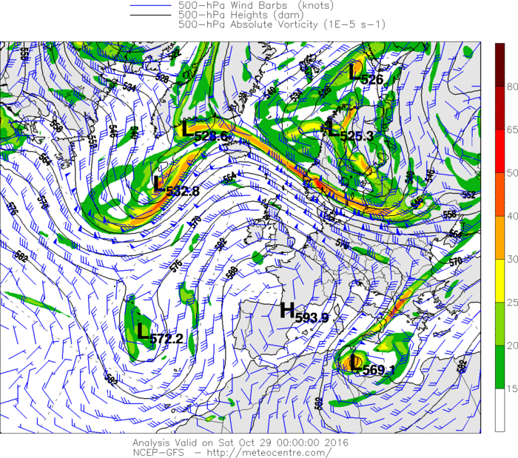
10/29 0z
The upper-level low has now moved SW towards Africa

Slide 22
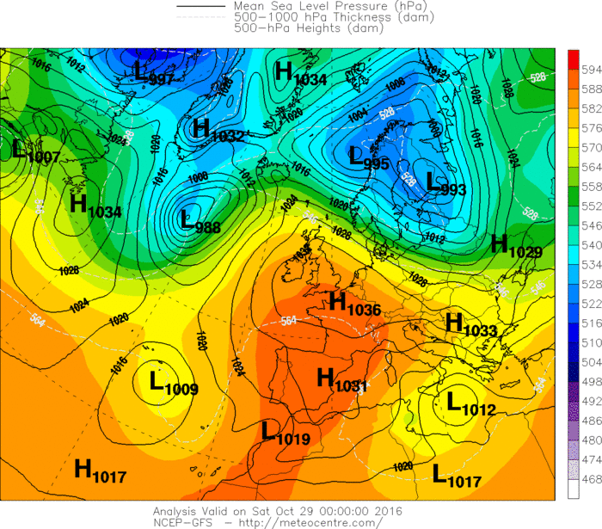
10/29 0z
The upper-level low has now moved SW towards Africa
It has triggered the formation of a surface low over the central Mediterranean Sea

Slide 23
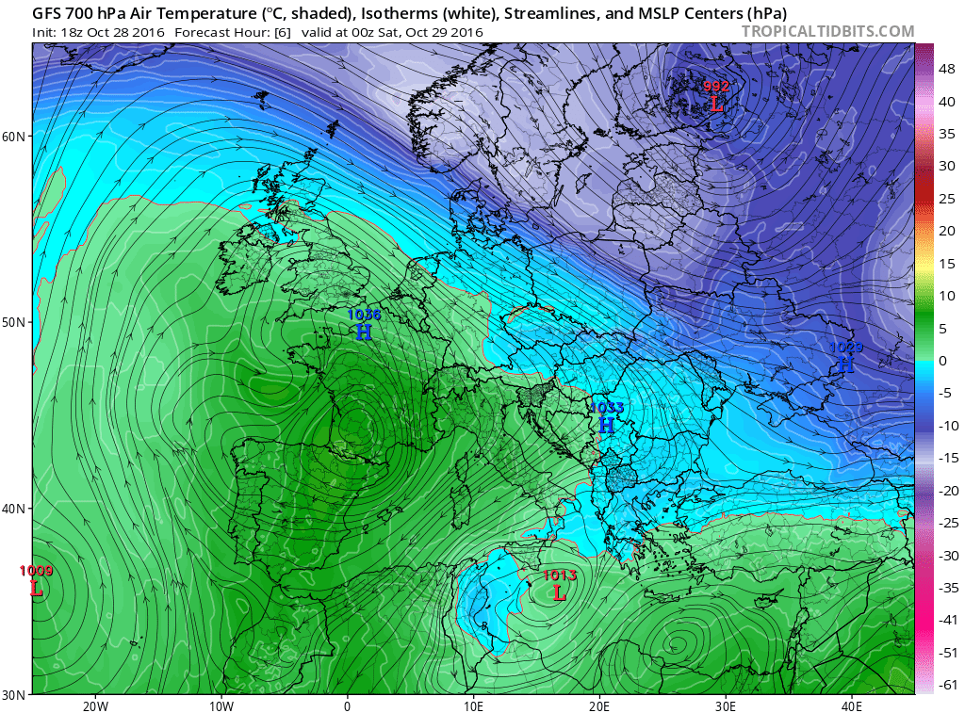
10/29 0z
The upper-level low has now moved SW towards Africa
It has triggered the formation of a surface low over the central Mediterranean Sea
Clear example of cold air intrusion that can trigger a medicane

Slide 24
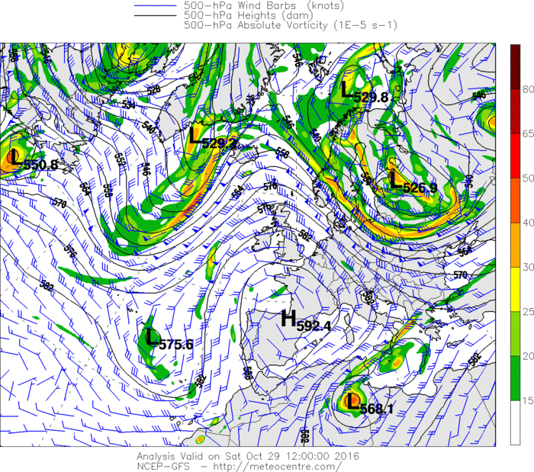
10/29 12z
The upper-level low continues to move SW, but now a new, weak upper-level low begins to form over the surface low
The system is now becoming a full fledged barotropic storm

Slide 25
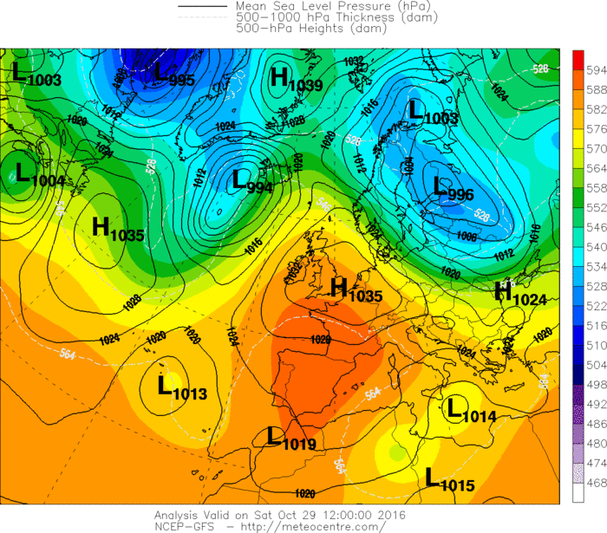
10/29 12z
The upper-level low continues to move SW, but now a new, weak upper-level low begins to form over the surface low
The system is now becoming a full fledged barotropic storm

Slide 26
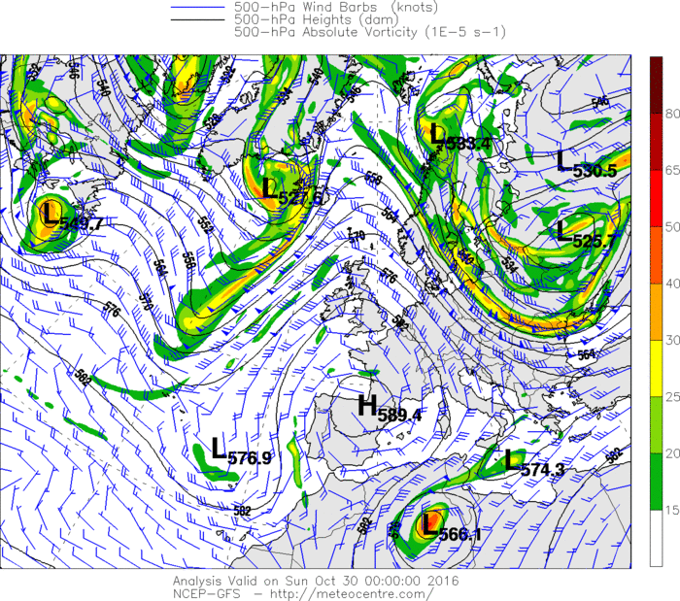
10/30 0z
90M is now moving ENE

Slide 27
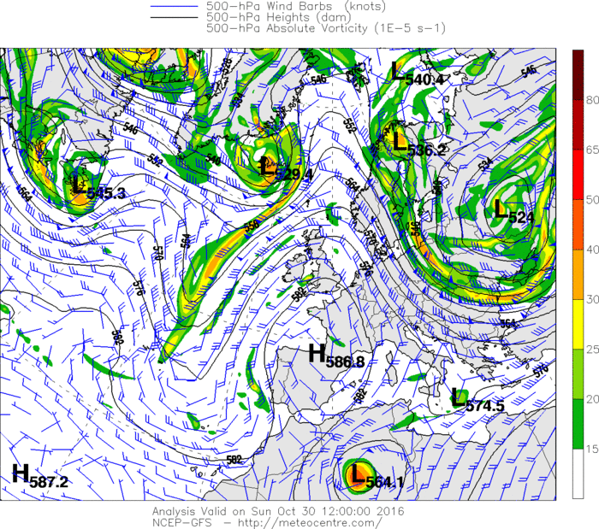
10/30 12z
Continues to move towards Greece
The initial upper-level low is now completely removed from 90M

Slide 28
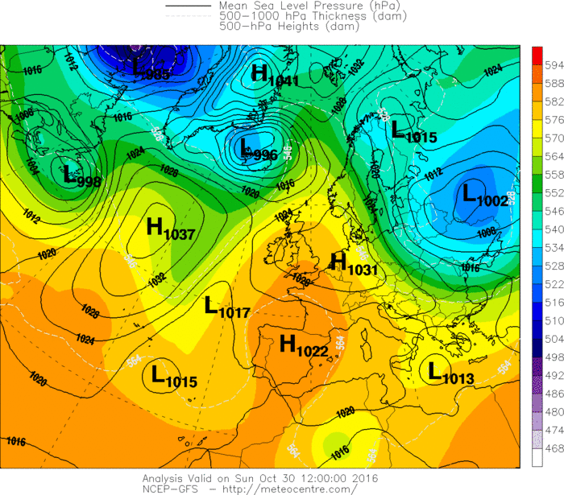
10/30 12z
Continues to move towards Greece
The initial upper-level low is now completely removed from 90M

Slide 29
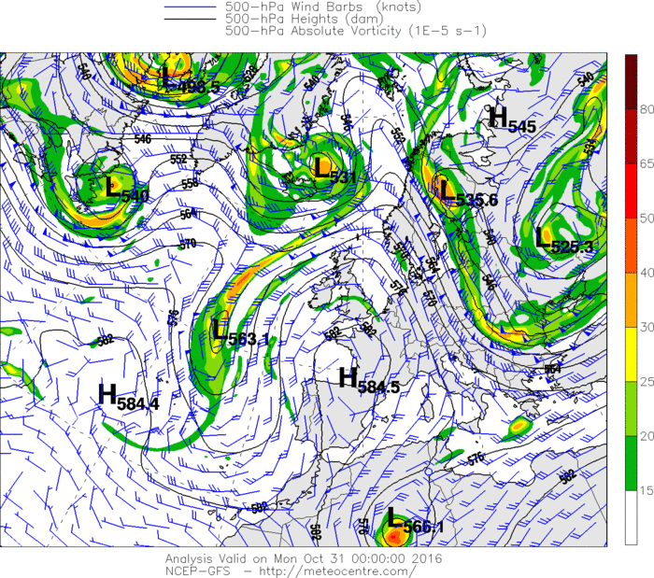
10/31 0z
90M is now deepening and nearing peak intensity SW of Greece

Slide 30
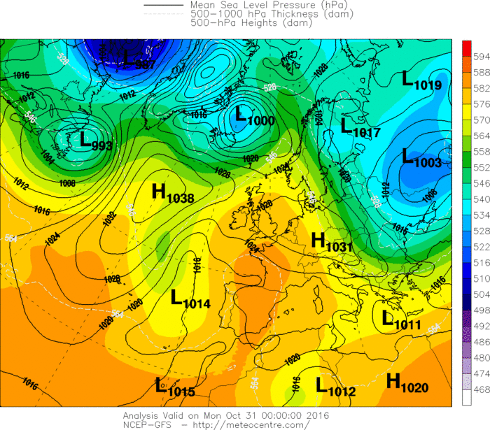
10/31 0z
90M is now deepening and nearing peak intensity SW of Greece

Slide 31
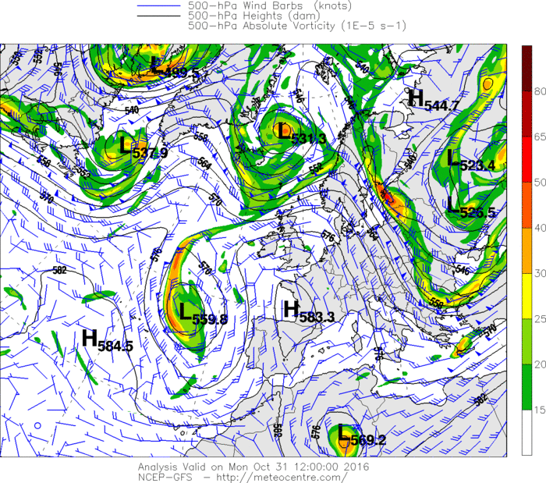
10/31 12z
90M is now crossing over Crete
An incoming trough east of the Black Sea will quickly absorb 90M into the mean flow

Slide 32
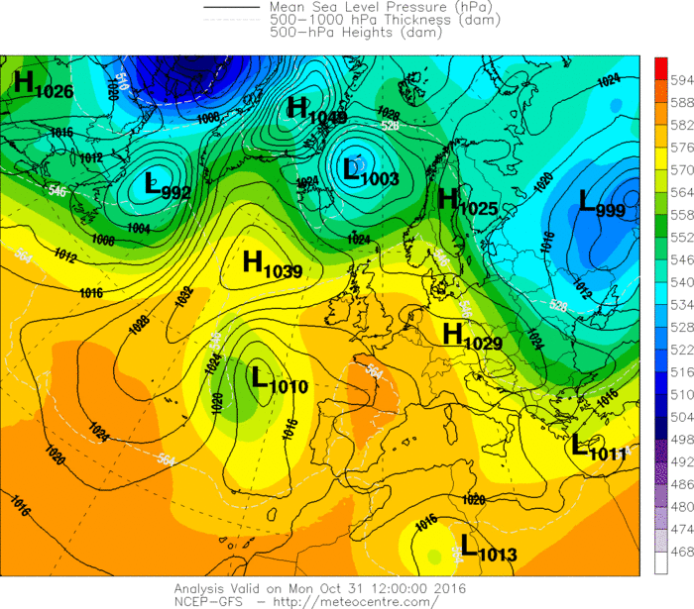
10/31 12z
90M is now crossing over Crete
An incoming trough east of the Black Sea will quickly absorb 90M into the mean flow

Slide 33
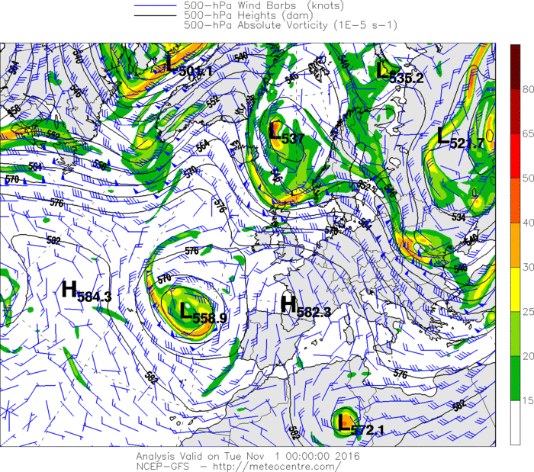
11/1 0z
90M has been absorbed

Slide 34
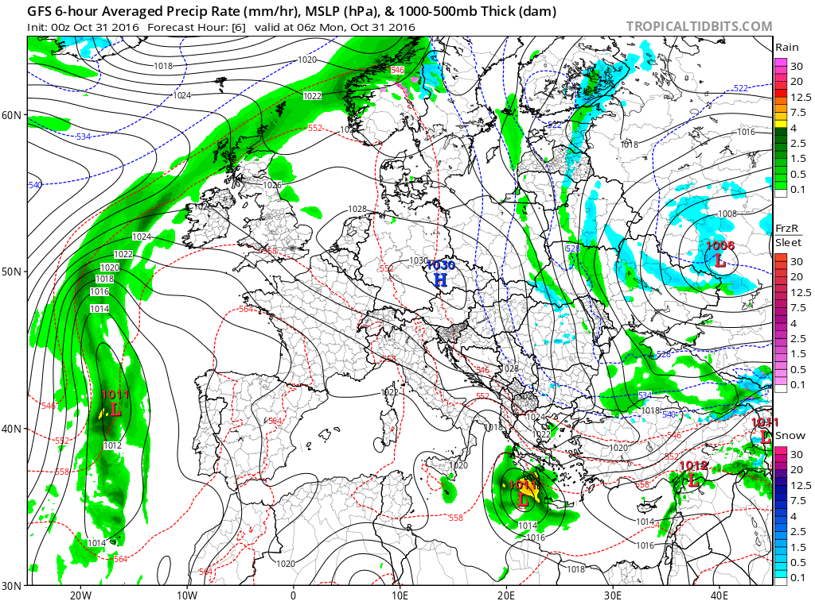
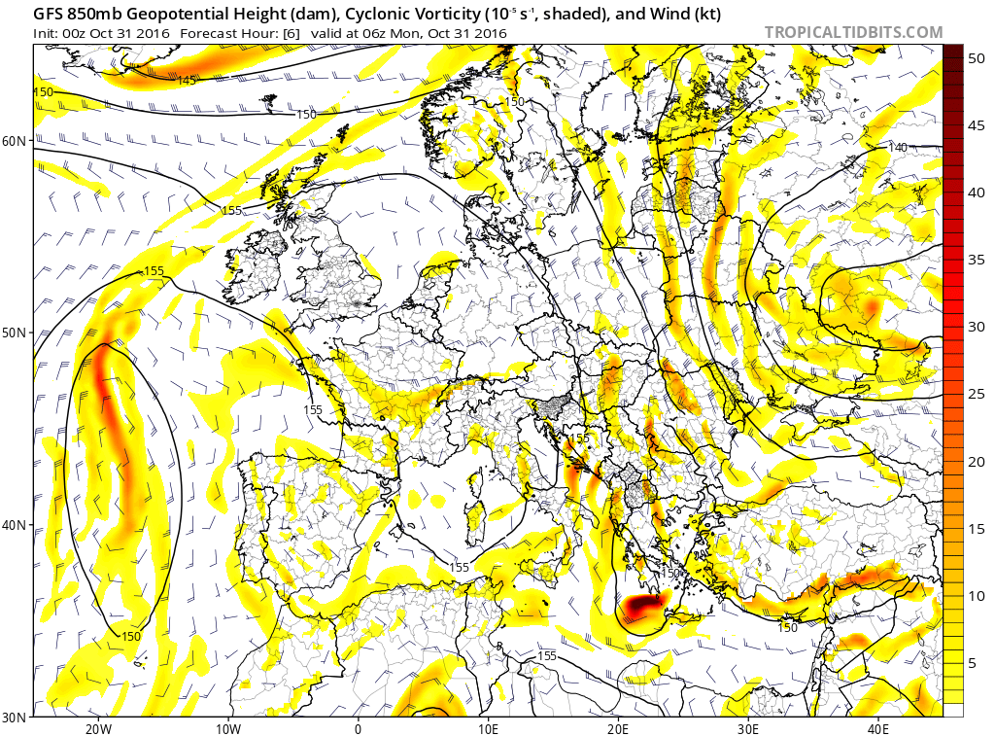
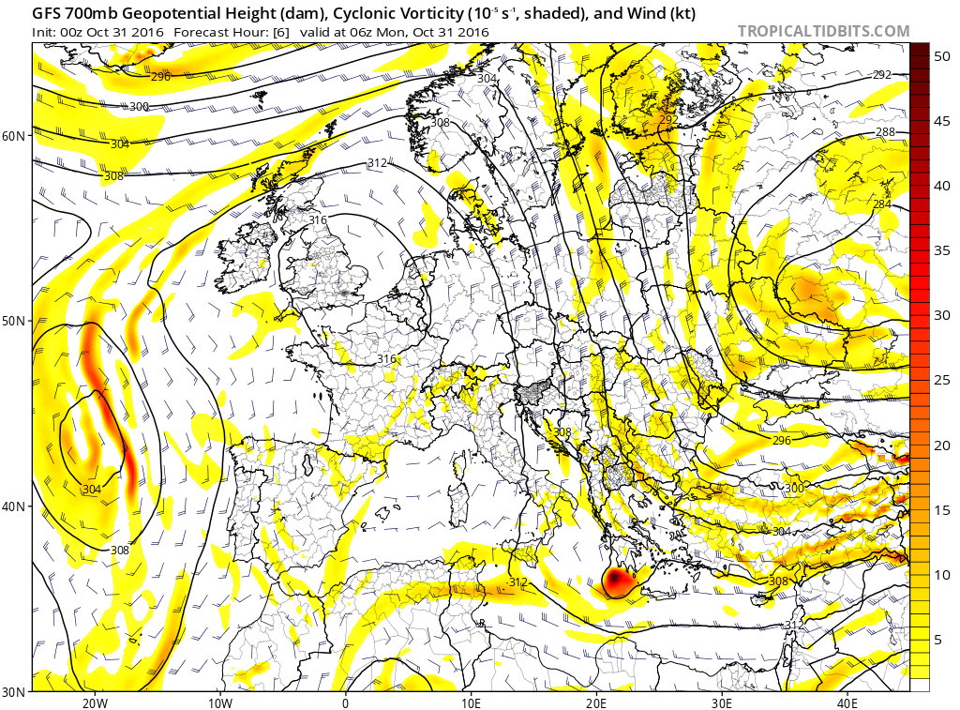
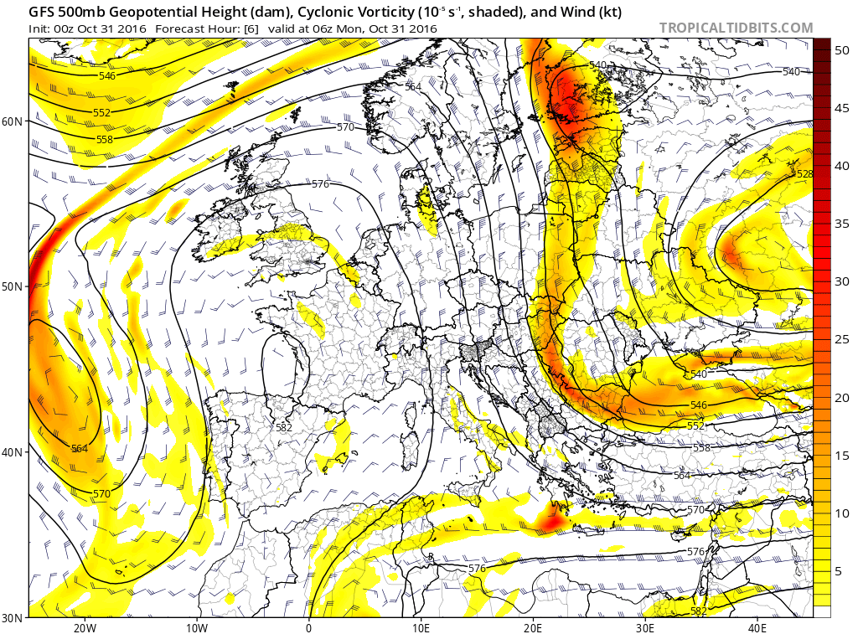
Barotropic Storm
90M was a vertically stacked system

Slide 35
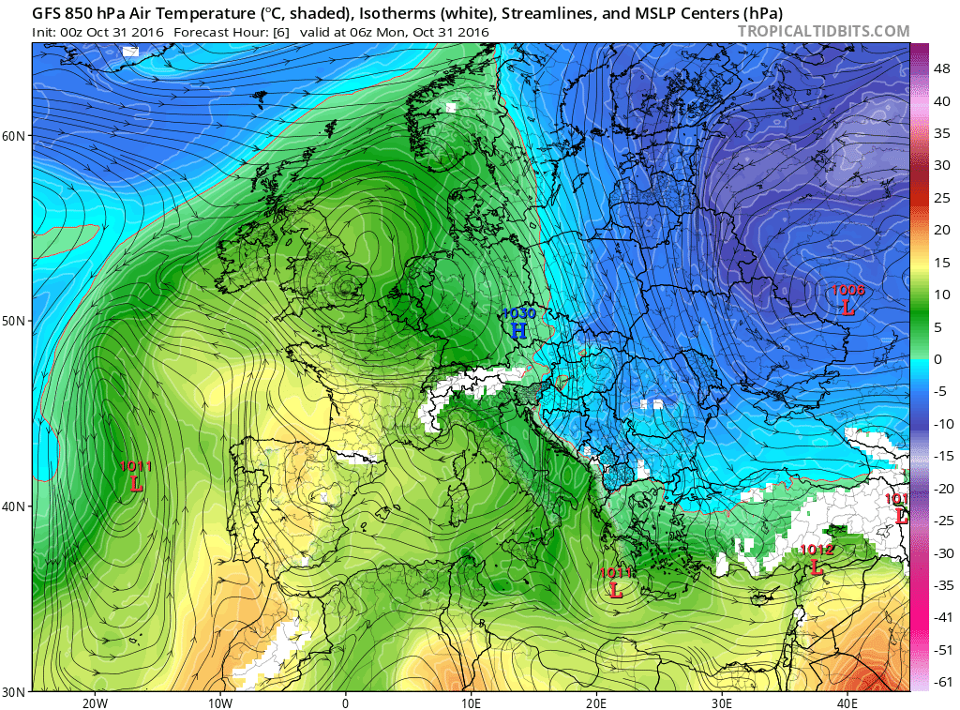
Barotropic Storm
90M was a vertically stacked system
90M had a warm core with no surface temperature boundaries

Slide 36
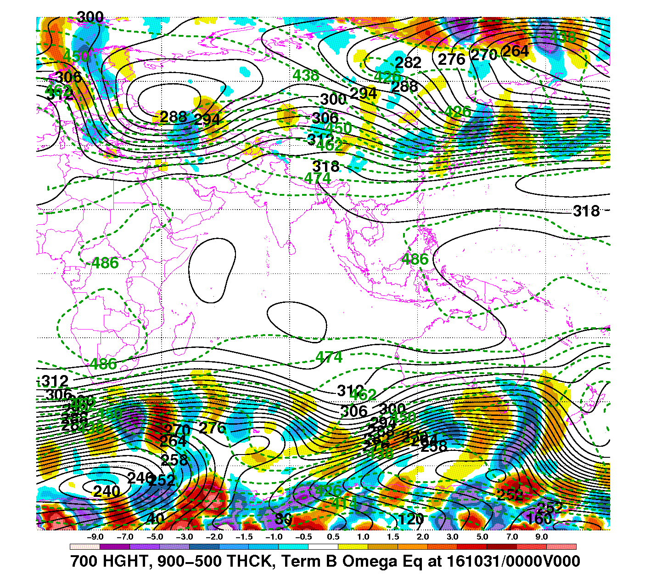
QG Analysis: Temperature Advection
Since 90M is barotropic there should be little to no temperature advection
Source: Dr.Galarneau’s QG-Analysis Page

Slide 37
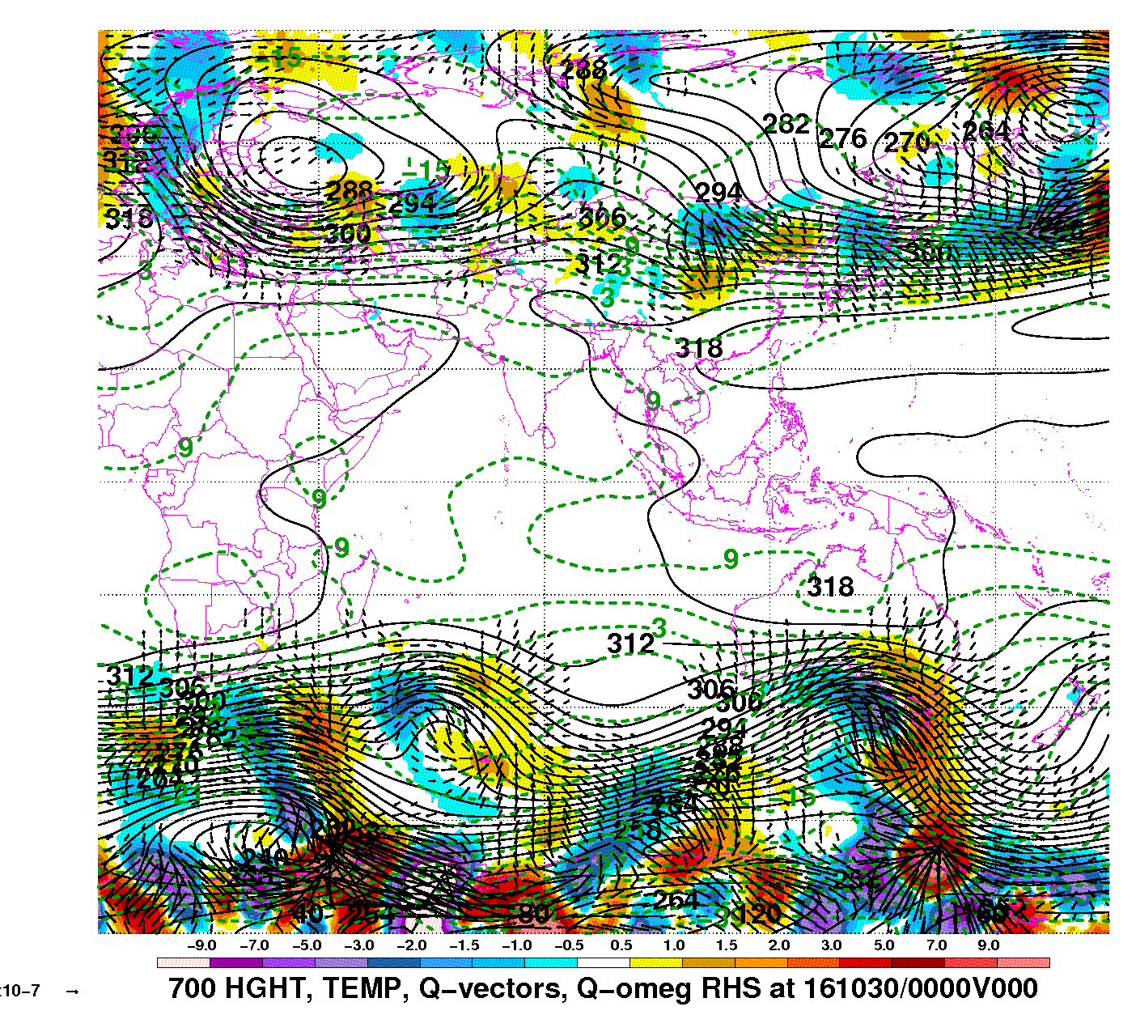
QG Analysis: Q-Vector
Q-vector analysis shows no convergence, thus no rising motion
This is wrong, since there will be rising motion within a TC and it is a sub-synoptic system
QG analysis failed for 90M
Source: Dr.Galarneau’s QG-Analysis Page

Slide 38
Conclusion
A rare tropical cyclone formed in the Mediterranean Sea over Halloween weekend
It formed as a result of a cutoff low moving over the unseasonably warm sea surface temperatures of the Mediterranean Sea
QG analysis failed since tropical cyclones are barotropic

Slide 39
References
Climatology and 90M
  Cavicchia, L.; von Storch, H.; Gualdi, S. (September 2014). "A long-term climatology of medicanes" (PDF). Climate Dynamics. Springer Science+Business Media. 43 (5–6): 1183–1195.
  Emanuel, K. (June 2005). "Genesis and maintenance of 'Mediterranean hurricanes'" (PDF). Advances in Geosciences. European Geosciences Union. 2: 217–220.
  Moscatello, A.; Miglietta, M.M.; Rotunno, R. (October 2008). "Observational analysis of a Mediterranean 'hurricane' over southeastern Italy" (PDF). Weather. Royal Meteorological Society. 63 (10): 306–311
  Tous, M.; Romero, R. (January 2013). "Meteorological environments associated with medicane development". International Journal of Climatology. Royal Meteorological Society. 33 (1): 1–14. doi:10.1002/joc.3428
  https://weather.com/news/weather/news/medicane-tropical-storm-mediterranean-sea-31oct2016
  https://www.wunderground.com/blog/JeffMasters/another-quirky-medicane-hits-the-eastern-mediterranean
  http://www.nhc.noaa.gov/aboutgloss.shtml
Images and Models
  http://meteocentre.com/models/
  http://www.tropicaltidbits.com/analysis/models/
  http://cersat.ifremer.fr/
  http://cimss.ssec.wisc.edu/goes/blog/archives/22492
  http://www.hnms.gr/hnms/english/index_html
  http://moe.met.fsu.edu/cyclonephase/help.html

