Slide 1
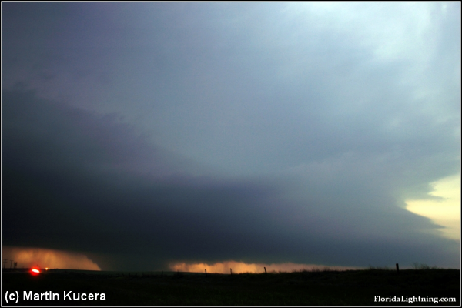
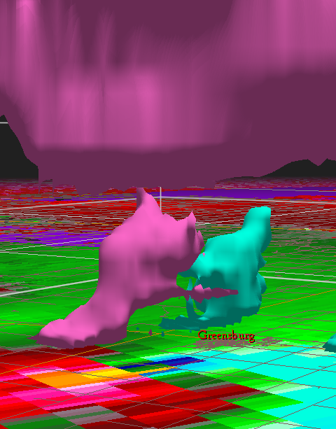
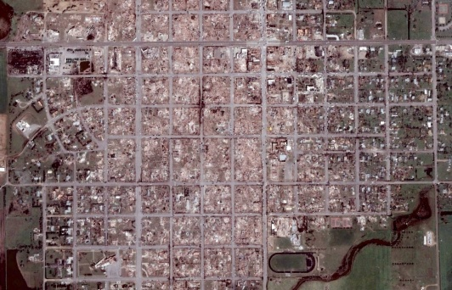
Historic Greensburg Supercell of 4 May 2007
Anatomy of a Severe Local ‘Superstorm’
Mike Umscheid
National Weather Service Forecast Office – Dodge City, KS
In collaboration with
Leslie R. Lemon
University of Oklahoma/CIMMS,
NOAA/NWS Warning Decision Training Branch, Norman, OK
Great Lakes Meteorology Conference – Valparaiso, IN
April 5, 2008

Slide 2
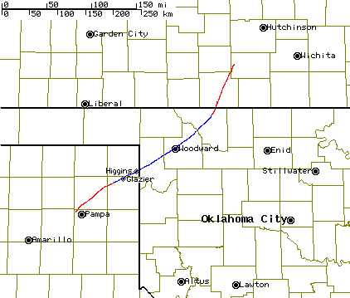
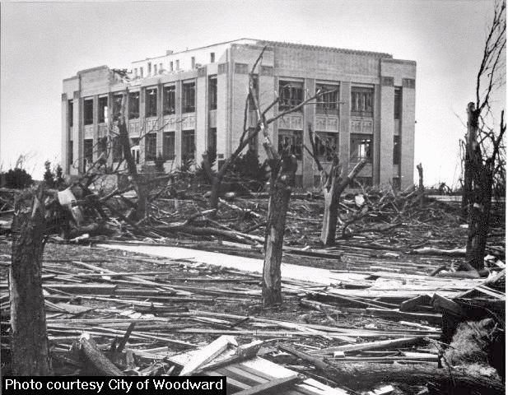
A Thunderstorm Spectrum
Single Cell
Multi-cell
(cluster)
Multi-cell
(line)
Supercell
Short-lived,
non-tornadic supercells
Longer-lived (2-4hrs),
one or two tornadic cycles
Courtesy NWS Norman
Severe Local “Superstorm”
6+ hrs, 2-3 significant tornadoes
(or one ultra long-lived sig tor),
Many other smaller ones.
Widespread destruction.
9 April 1947
Woodward, OK

Slide 3
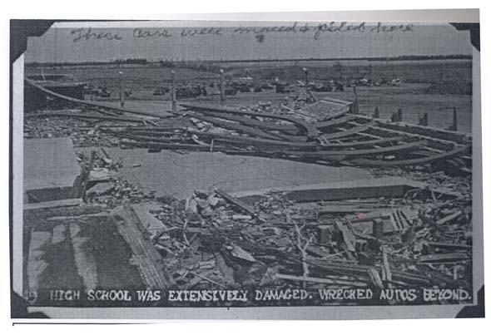
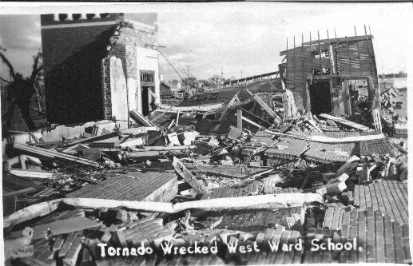
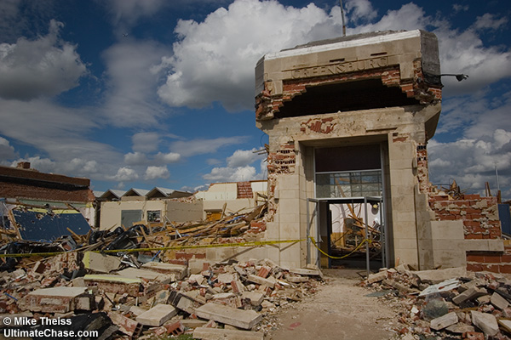
Woodward – Udall – Greensburg
Udall
Woodward
10:35 pm
8:42 pm
~ ¾ to 1 mile wide
82 fatalities
1.8 miles wide
107 fatalities
Photos courtesy NWS ICT,
NW OK Genealogical Society,
Mike Theiss
Times CST
11 fatalities
1.7 miles wide
8:50 pm
Greensburg

Slide 4
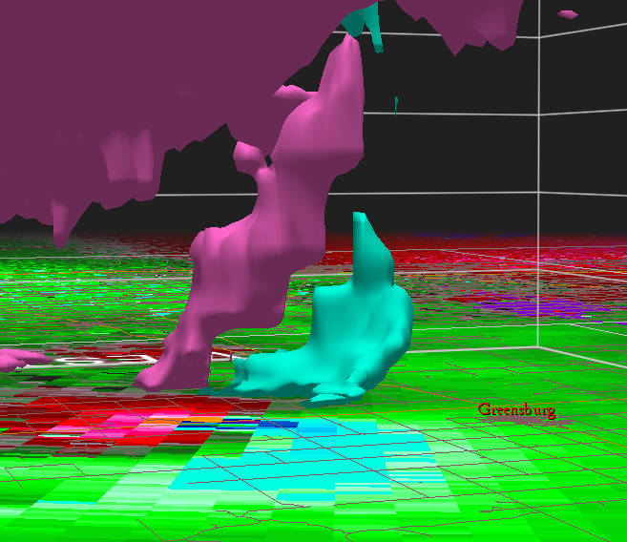
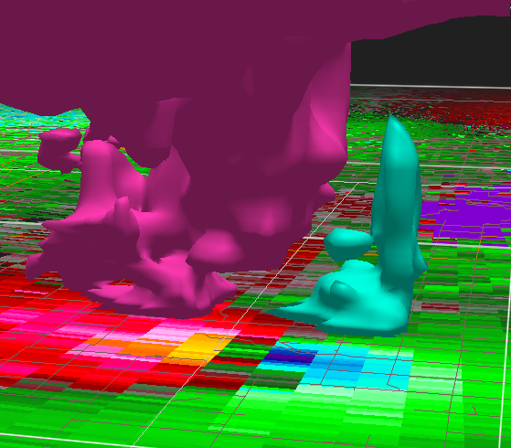
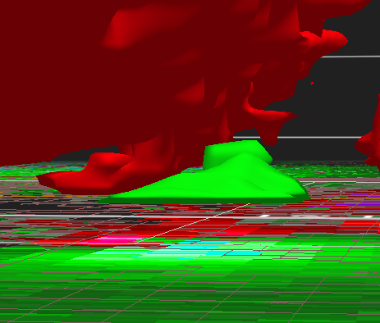
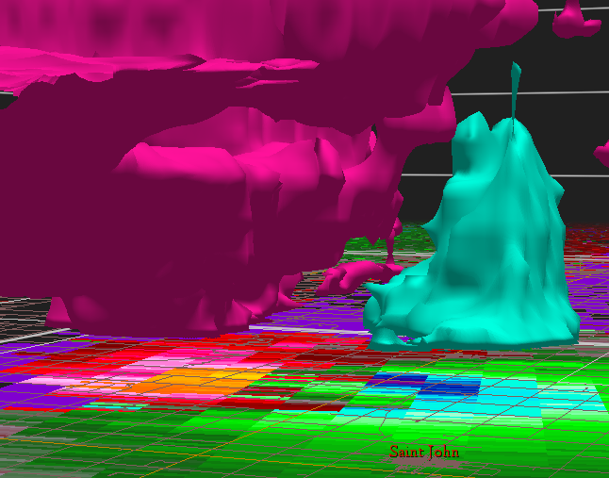
A little preview…
EF5
EF3 (+)
0237
0331
EF3 (+)
EF3
0347
0437
1 supercell thunderstorm – 20 tornadoes, 4 massive tornadoes spanning
3 hours w/ no break, farm community obliterated, very well-documented by chasers

Slide 5
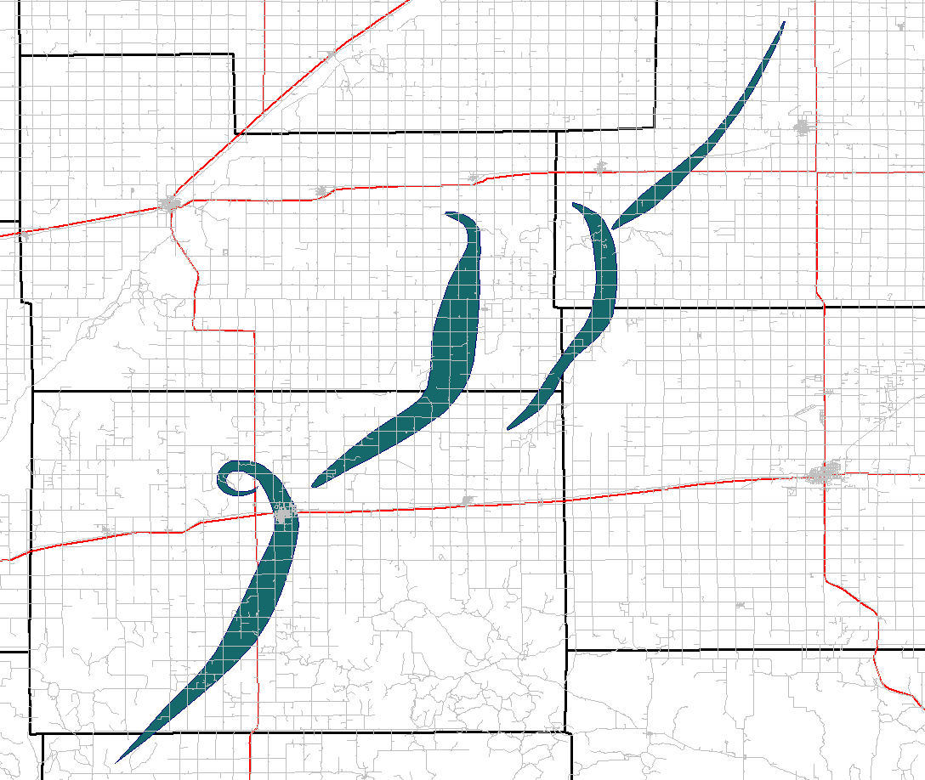
“The Big 4”
Rating: EF3 (strong)
Duration: 65 min.
Length: 23.5 mi
Mean Width: 1.5 mi
Max Width: 2.2 mi
Damage Area: 35.4 mi² (A5)
Damage $$: 1.5 M
St. John
Macksville
Rating: EF3
Duration: 24 min.
Length: 17.4 mi
Mean Width: 0.6 mi
Max Width: 0.9 mi
Damage Area: 9.7 mi² (A4)
Fatalities: 1
Trousdale
Hopewell
Rating: EF5
Duration: 65 min.
Length: 28.8 mi
Mean Width: 1.1 mi
Max Width: 1.7 mi*
Damage Area: 32.9 mi² (A5)₁
Fatalities: 11
Damage $$: 250 M
Rating: EF3 (strong)
Duration: 58 min.
Length: 18.2 mi
Mean Width: 0.9 mi
Max Width: 1.2 mi
Damage Area: 15.6 mi² (A4)
Fatalities: 1
Haviland
Greensburg
₁ Thompson & Vescio, 19th SLS

Slide 6
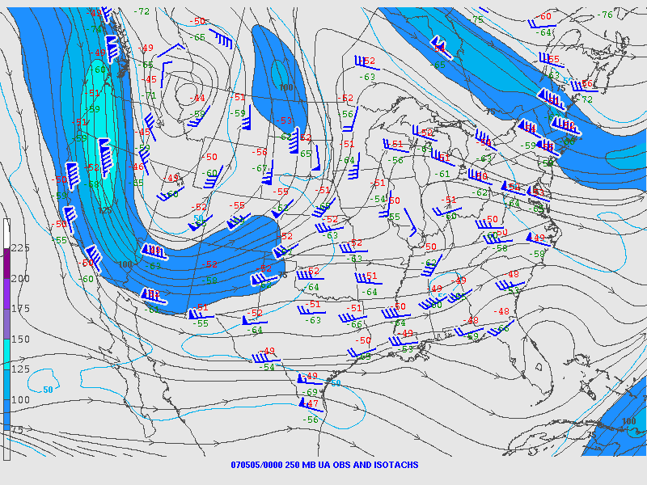
Synoptic Setting evening of May 4

Slide 7
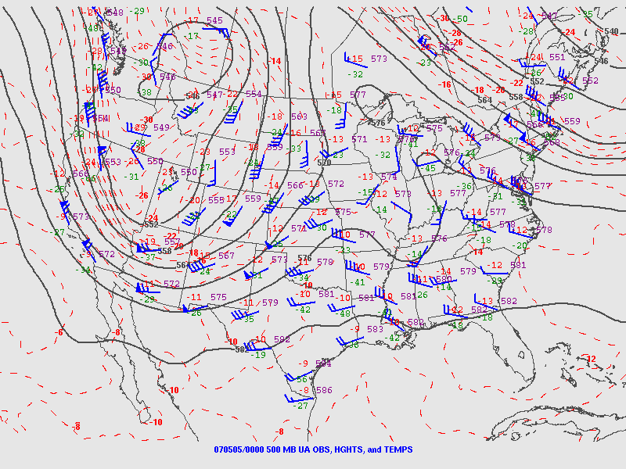
Synoptic Setting evening of May 4

Slide 8
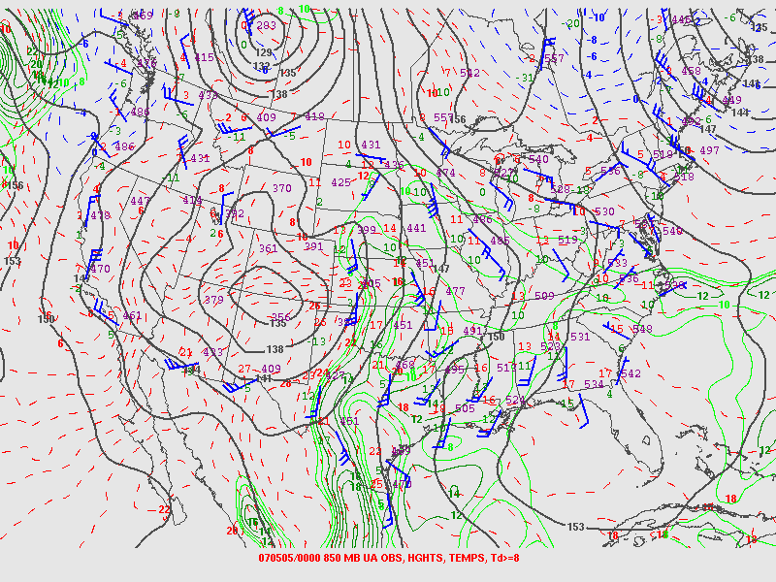
Synoptic Setting evening of May 4

Slide 9
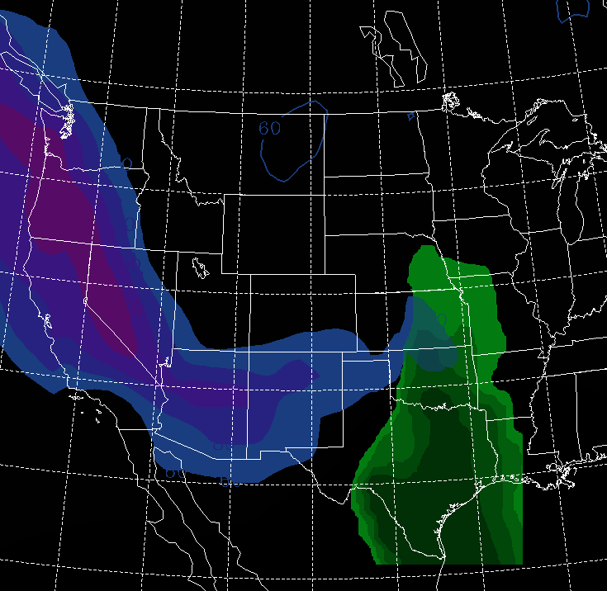
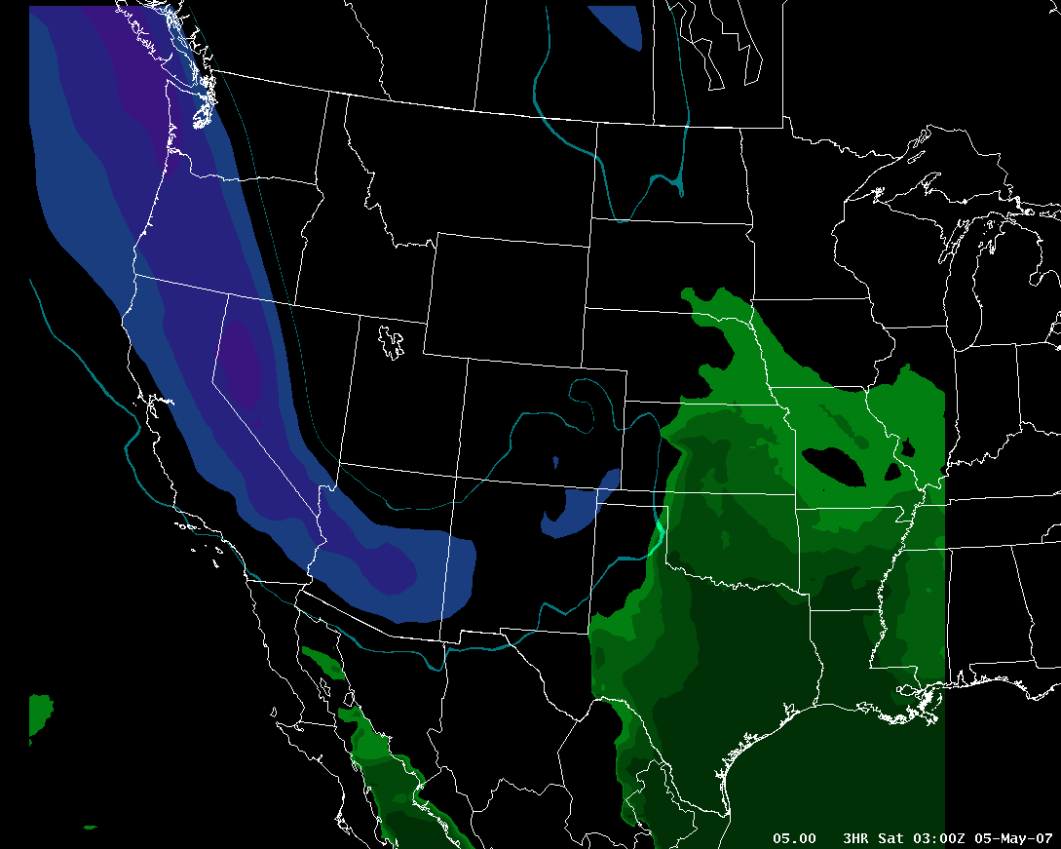
Synoptic Setting shades of May 3, 1999? (Moore, OK “F5” Tornado)
Jet stream in blue
Gulf of Mexico moisture in green
00 UTC, 1999 May 4
03 UTC, 2007 May 5

Slide 10
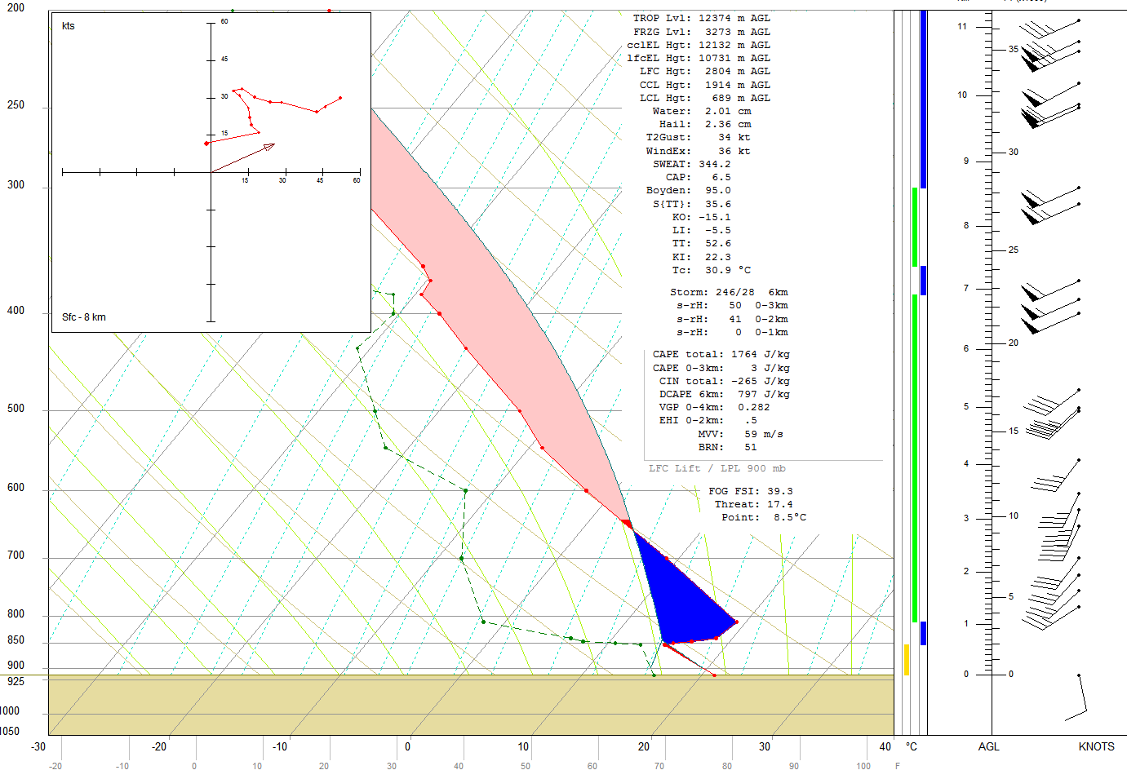
Sub-synoptic Setting
May 4 18z Sounding KDDC

Slide 11
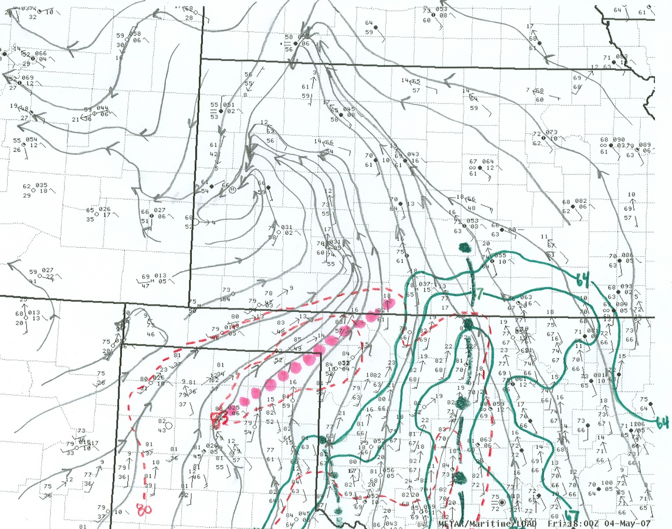
Sub-synoptic Setting surface analysis 18z

Slide 12
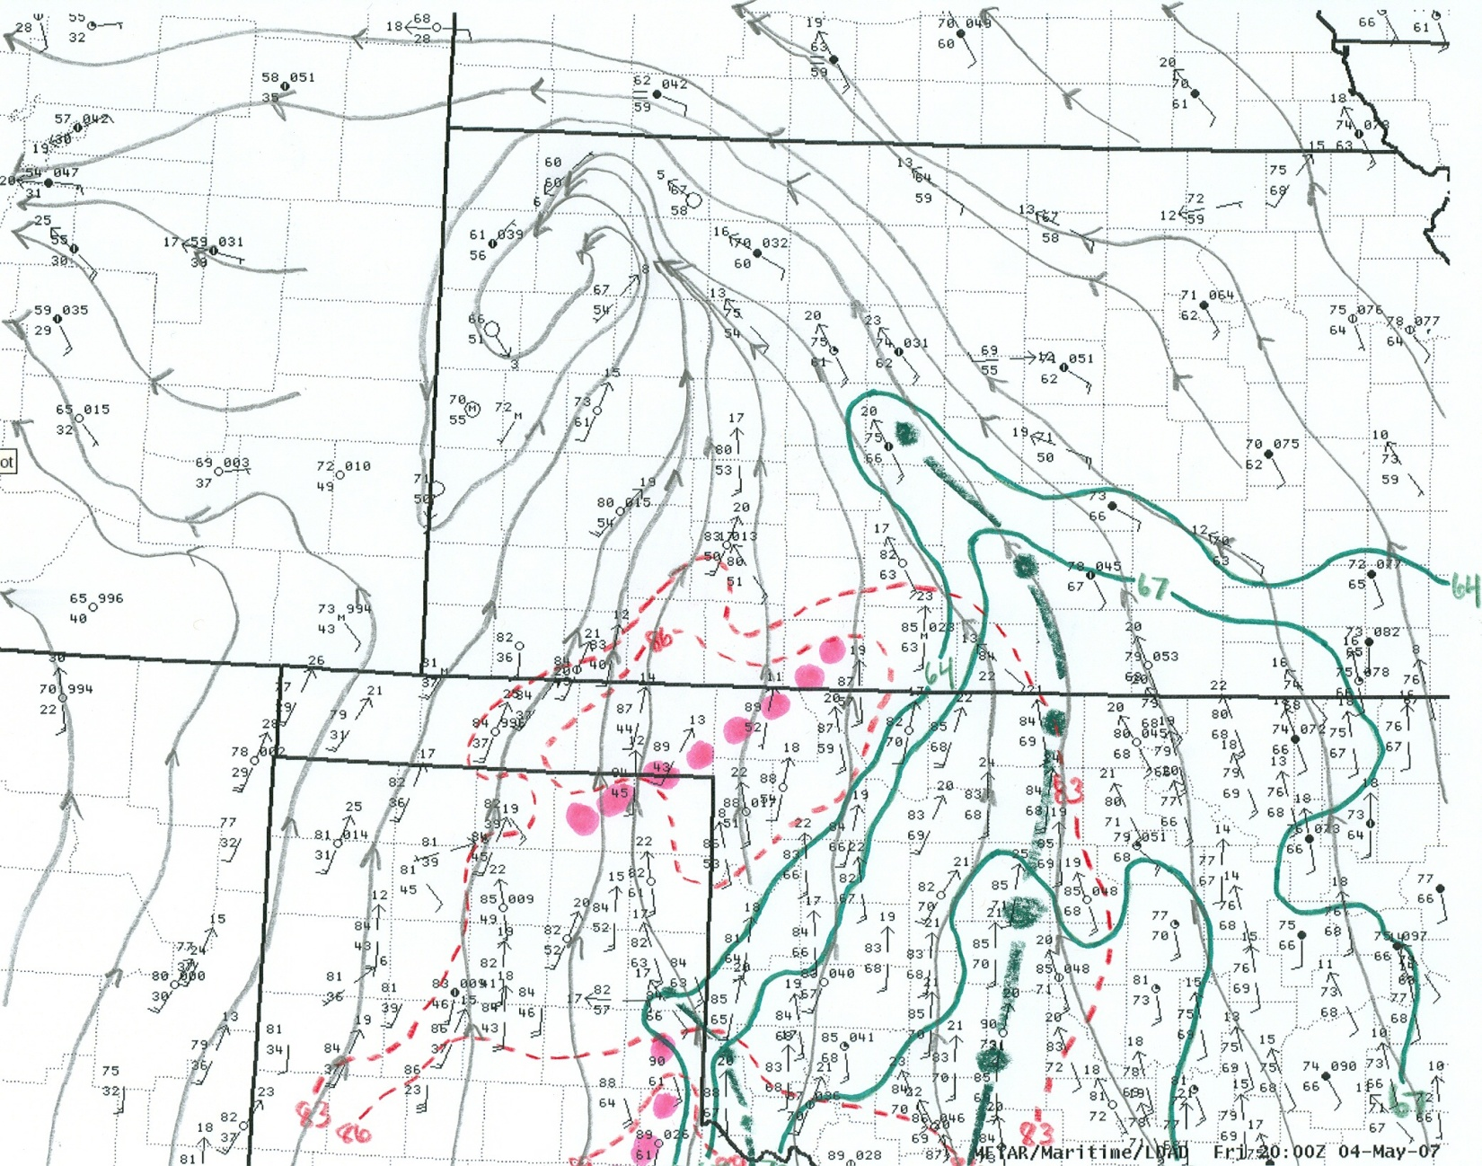
Sub-synoptic Setting surface analysis 20z

Slide 13
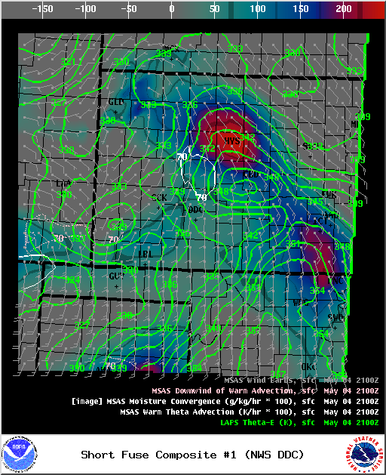
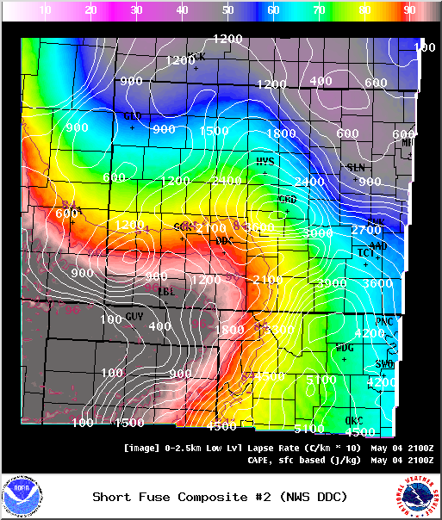
Sub-synoptic Setting short-fuse composite 21z

Slide 14
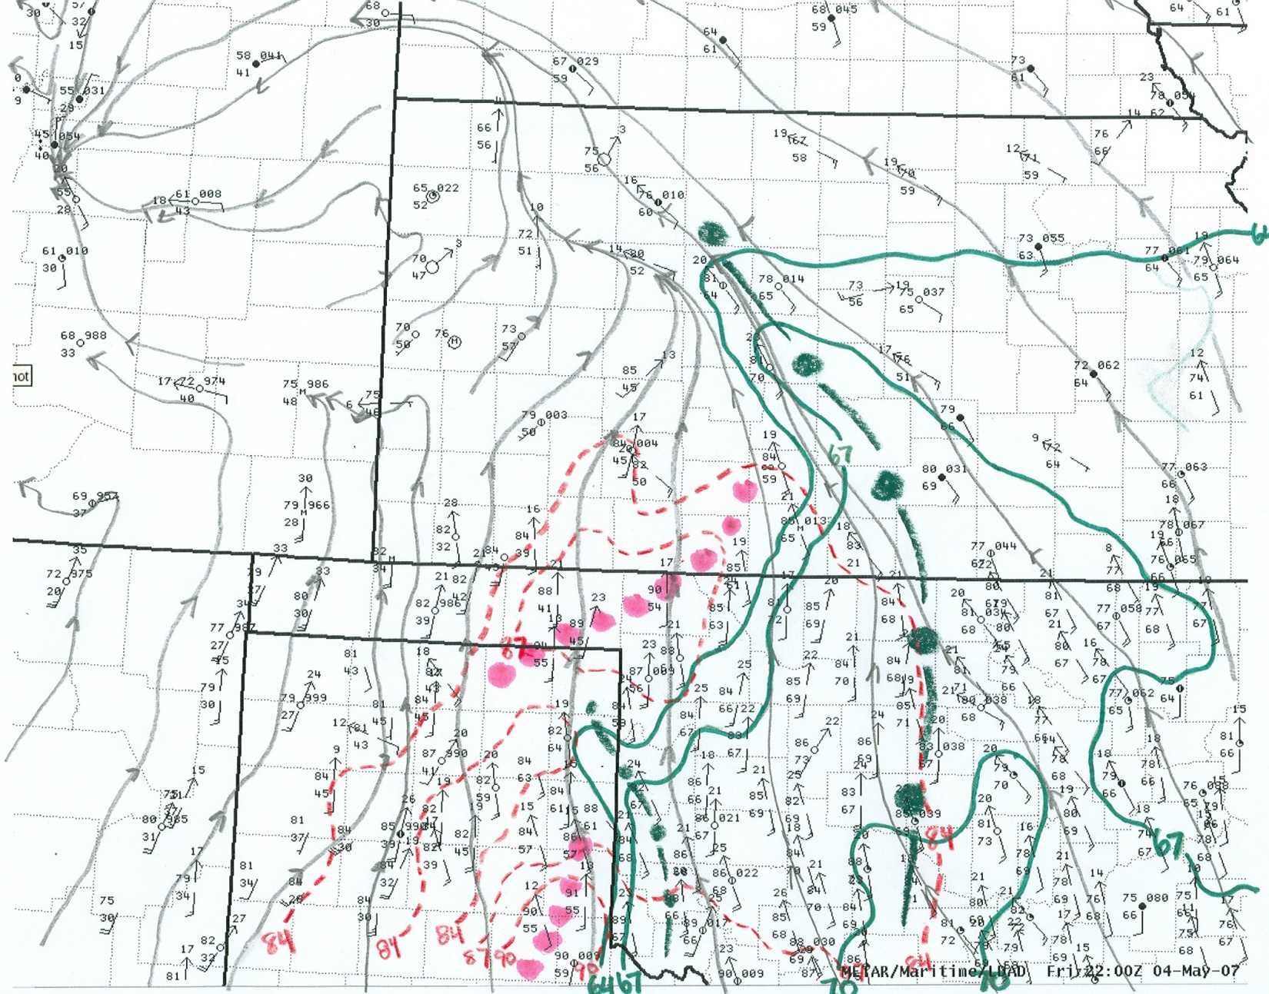
Sub-synoptic Setting surface analysis 22z

Slide 15
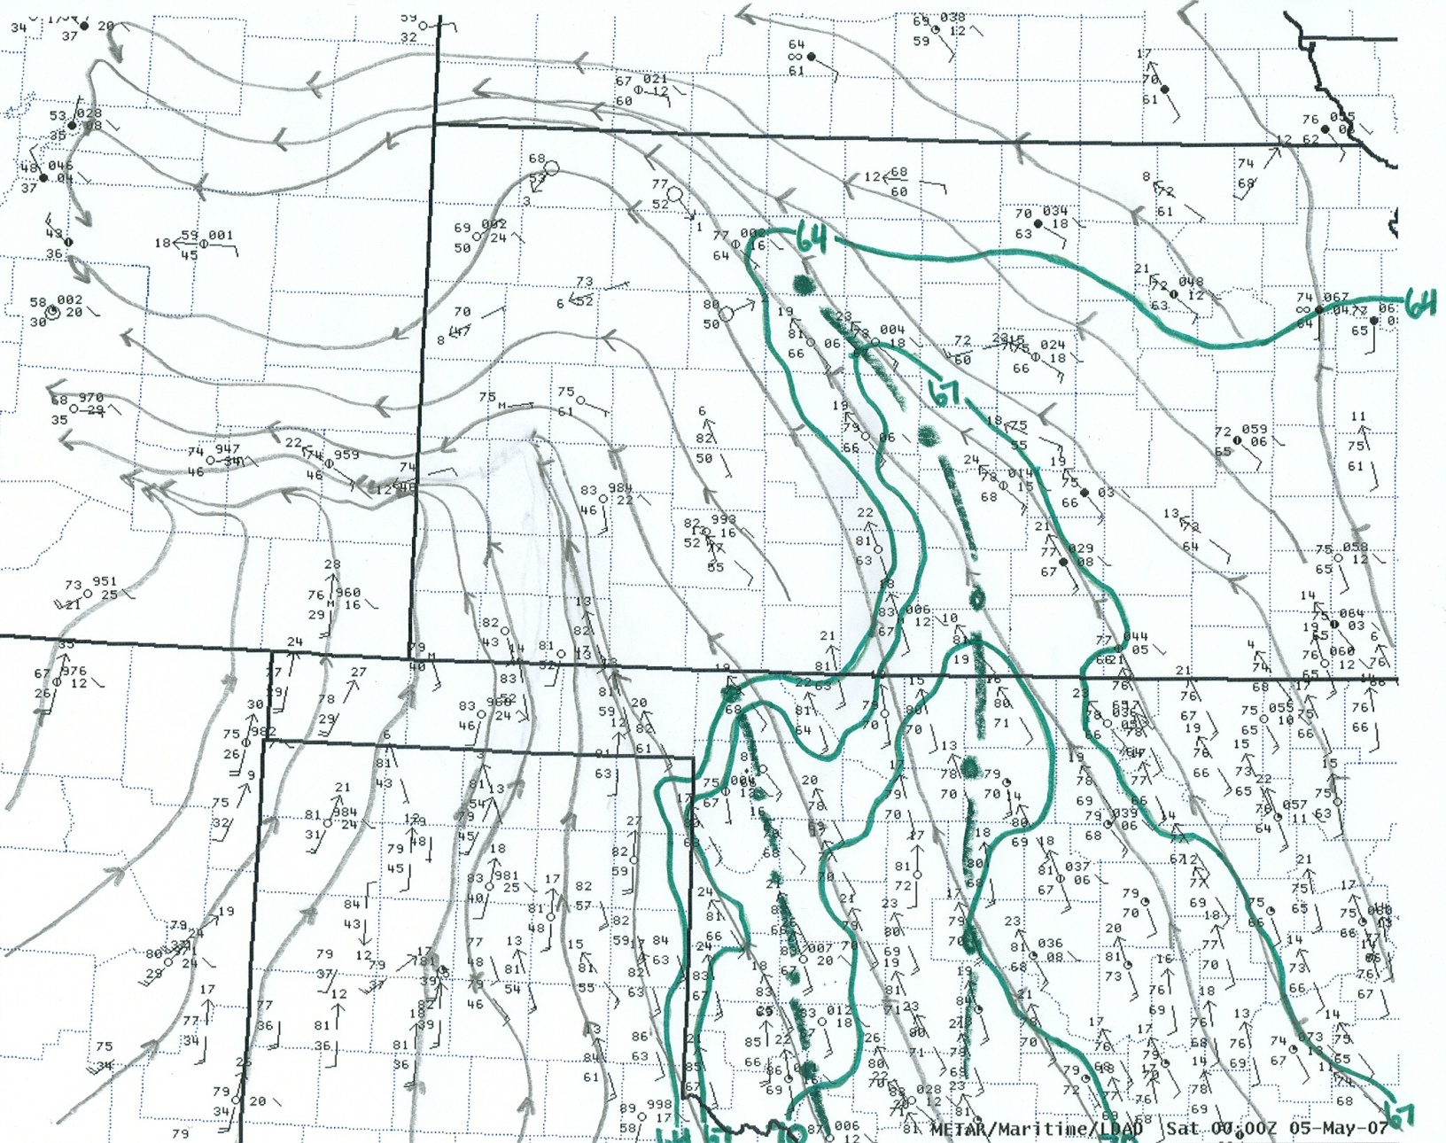
Sub-synoptic Setting surface analysis 00z

Slide 16
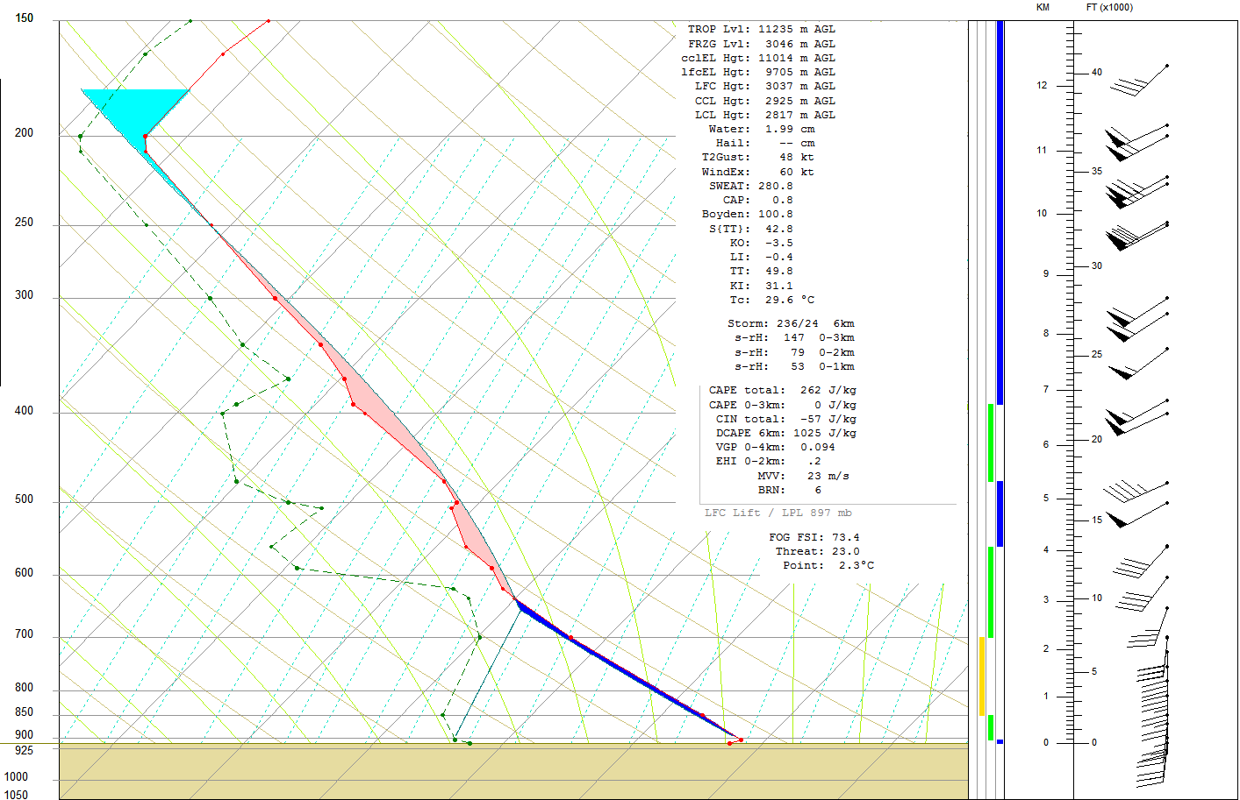
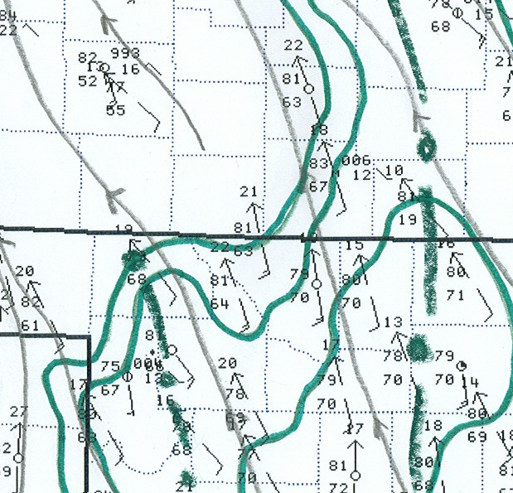
Sub-synoptic Setting
May 5 00z Sounding KDDC
46°
82°

Slide 17
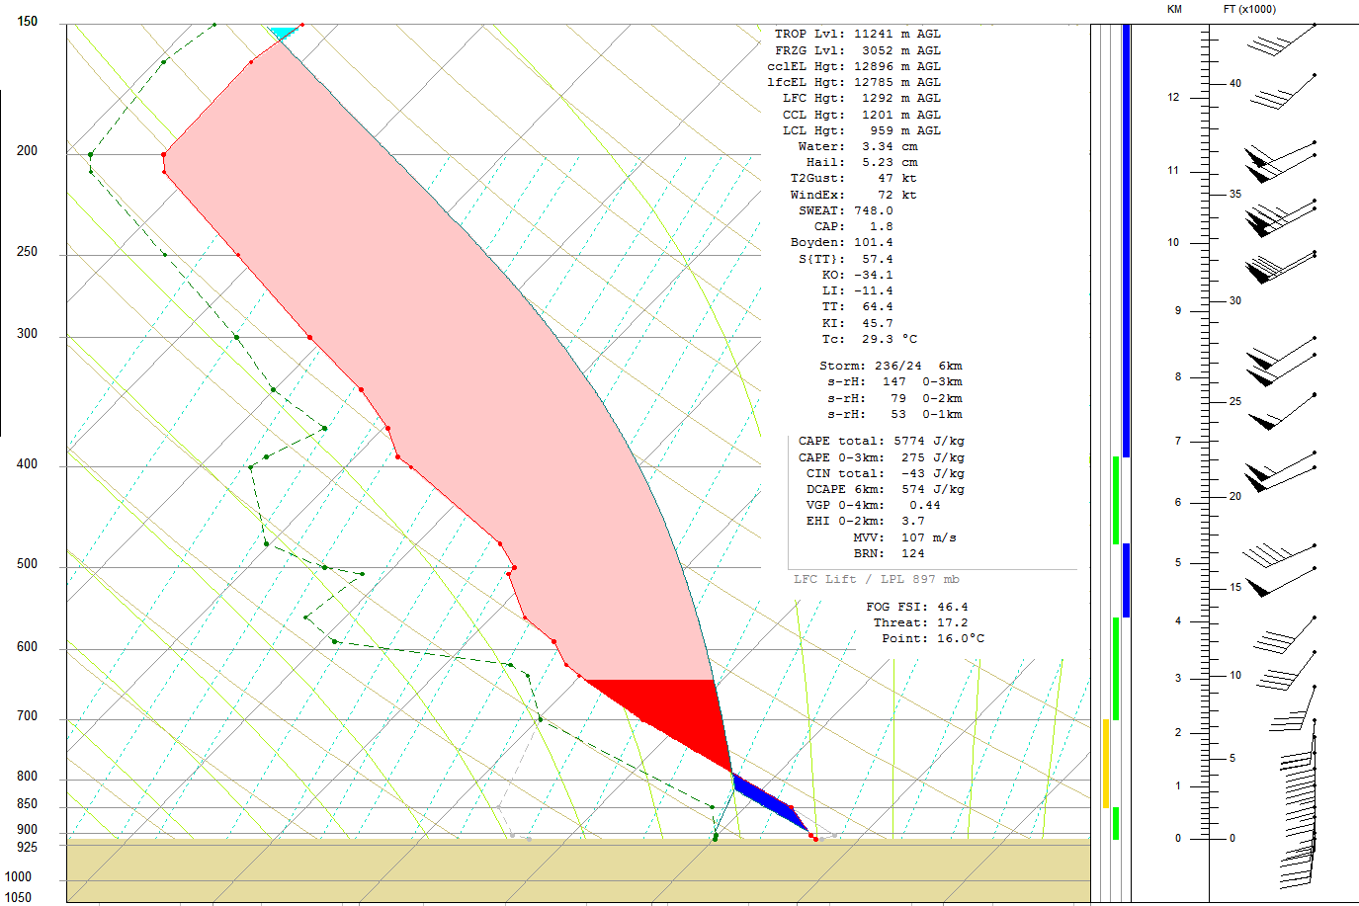
Sub-synoptic Setting
May 5 00z Sounding KDDC (modified )
68°
81°

Slide 18
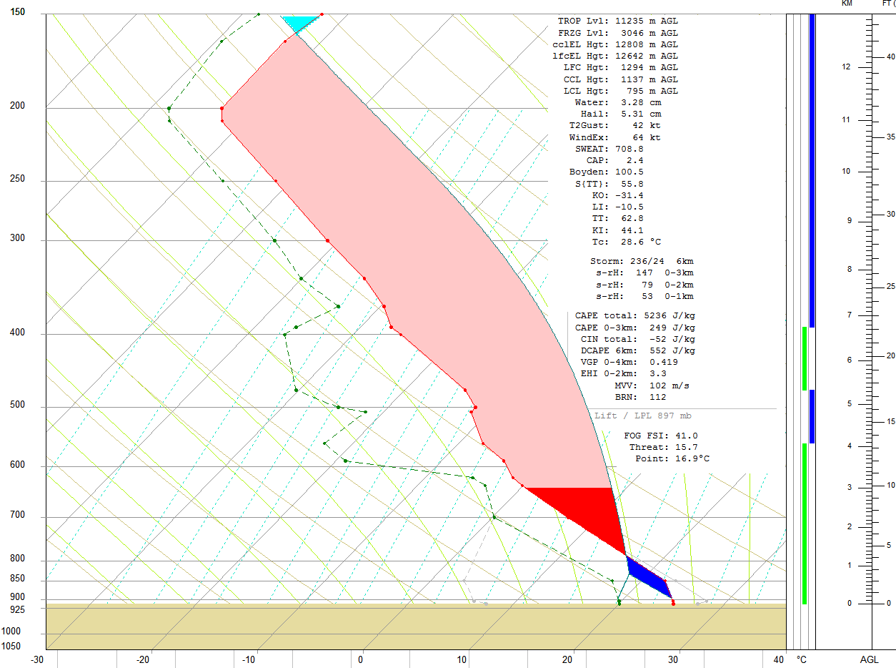
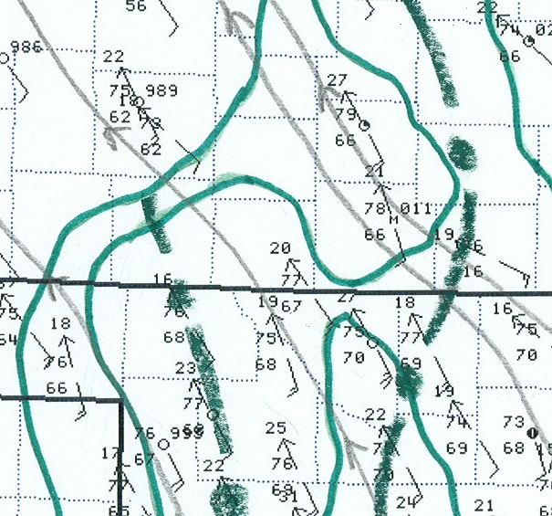
Sub-synoptic Setting
May 5 00z Sounding KDDC (modified for 02z )
68°
77°

Slide 19
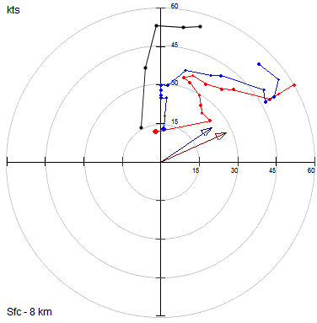
Sub-synoptic Setting
May 4 Hodograph Evolution KDDC
1
0-1km SRH
18z: 15 m²/s²
00z: 53 m²/s²
0240z: 240 m²/s²
1
1
02z CAPE/Shear
0-1km SRH: 240 m²/s²
Tot. CAPE: 5200 J/kg
0-1km EHI: 7.8
18z – ROAB – 0 to 8km
00z – ROAB – 0 to 8km
0240z – 88D – 0 to 1.6km

Slide 20
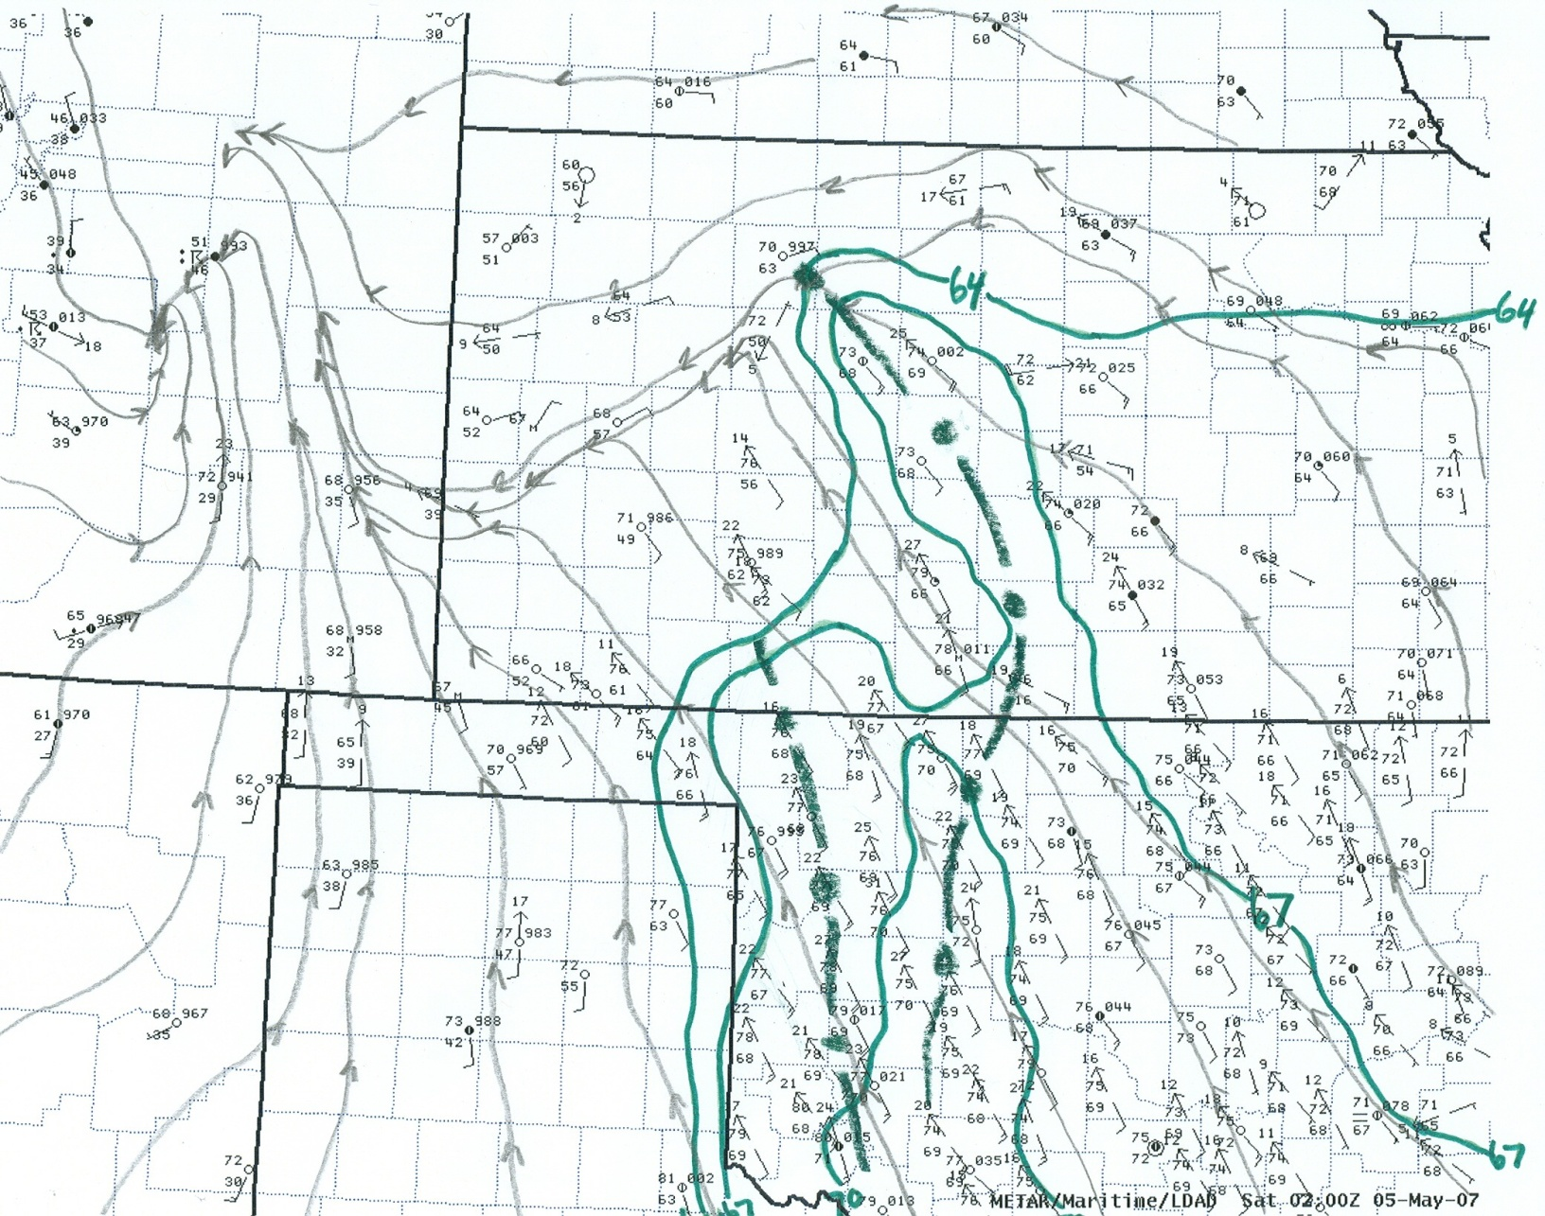
Sub-synoptic Setting surface analysis 02z

Slide 21
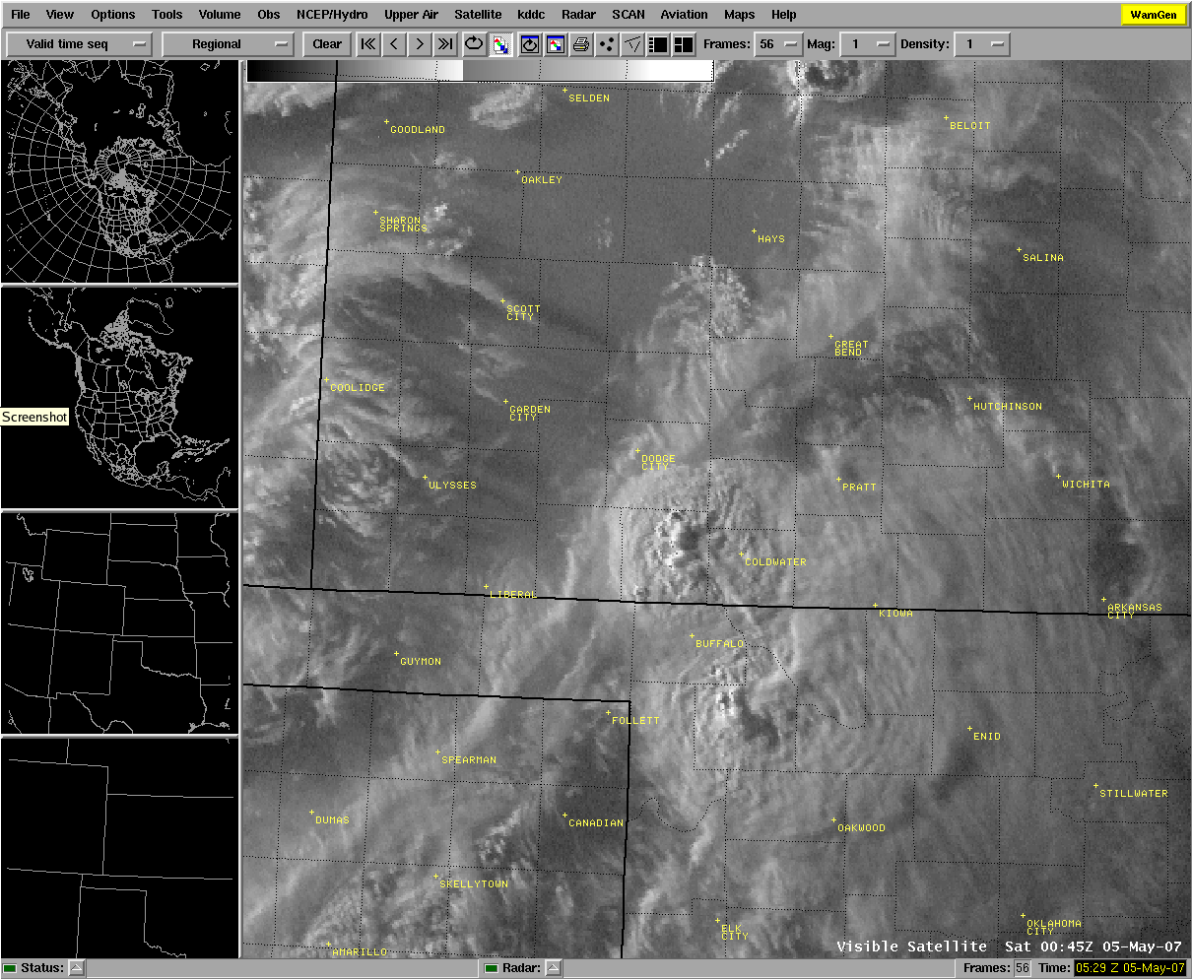
Visible Satellite Loop initiation of Greensburg supercell

Slide 22
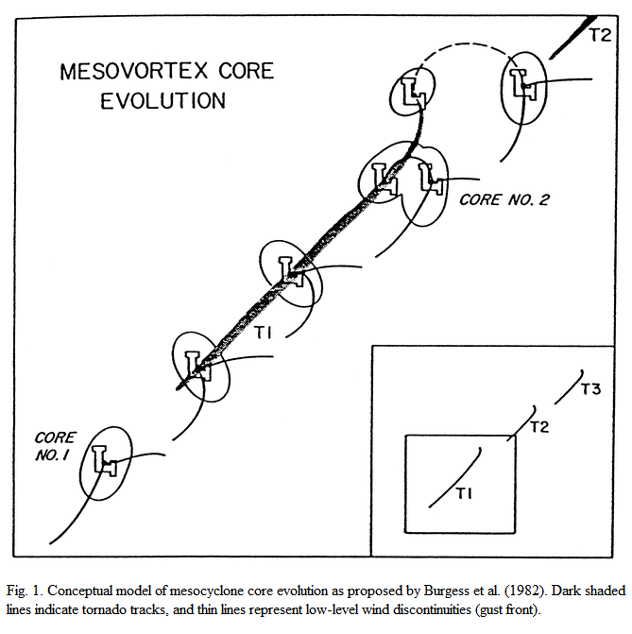
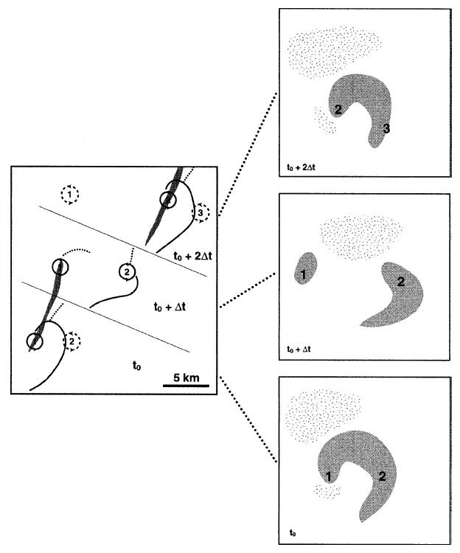
Cyclic Tornadogenesis
Burgess et al. 1982
Dowell & Bluestein 2002

Slide 23
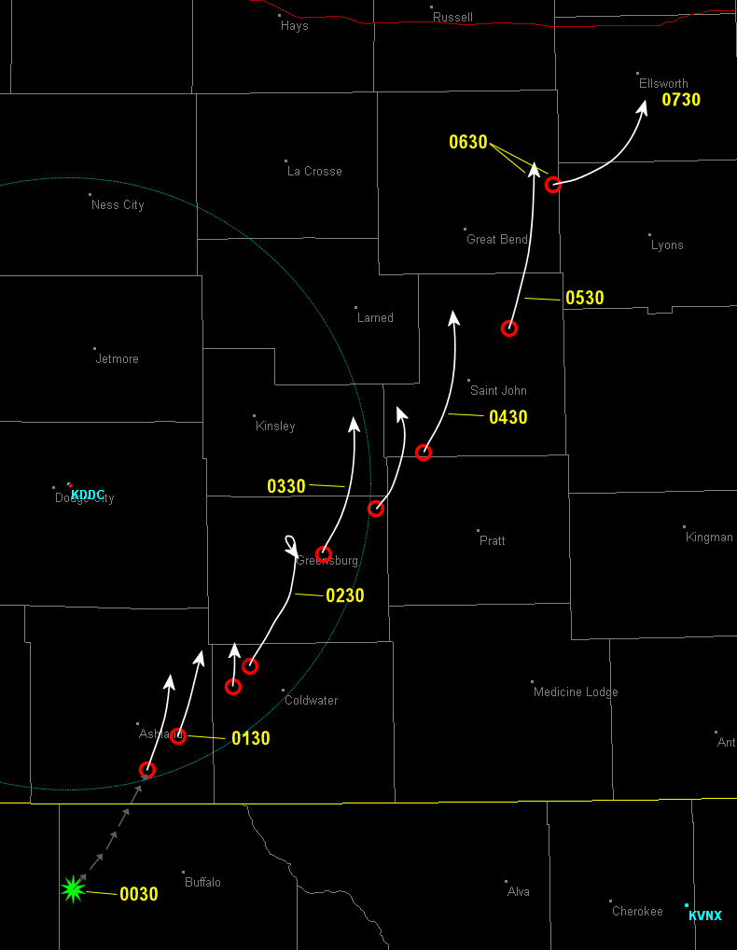
Track of Principle Mesocyclones/Tornado Cyclones
as analyzed from WSR-88D
Cycle #1 “Ashland”
Cycle #2 “Sitka”
Cycle #3 “Protection”
Cycle #4 “Greensburg” EF-5
Cycle #5 “Trousdale” high EF-3
Cycle #6 “Hopewell-Macksville” high EF-3
Cycle #7 “Macksville 2” EF-3
Cycle #8 “Hudson-Ellinwood”
Cycle #9 “Bushton”
9
8
7
“The Big 4”
6
5
4
2
3
1

Slide 24

Greensburg Supercell a timeline
8:00 pm
9:00
10:00
11:00
12:00 am
1:00
2:00
Central daylight time
EF0
EF1
20 tornadoes from
~8:30pm to ~2:10am
EF3
EF5

Slide 25
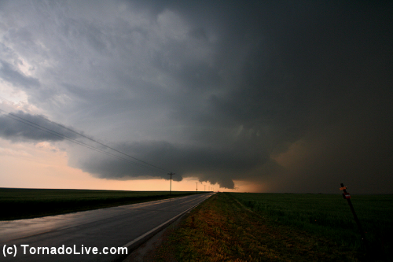
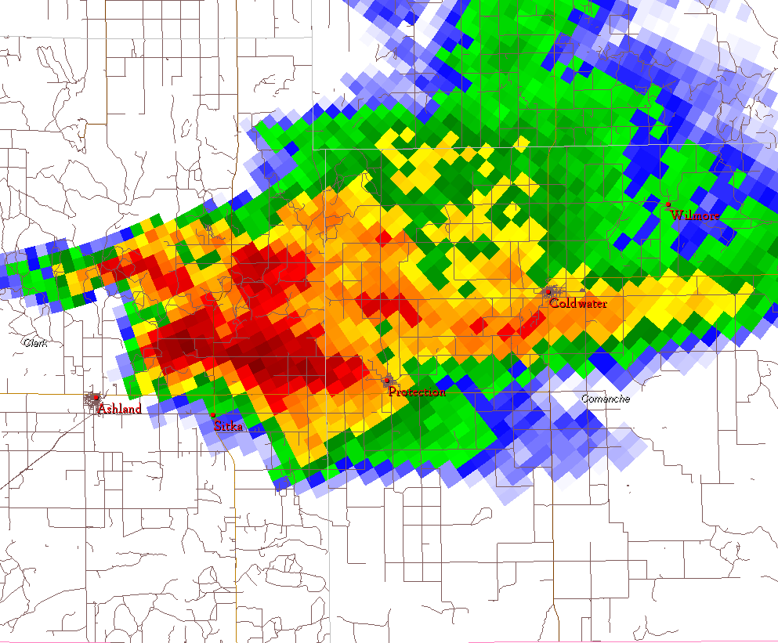
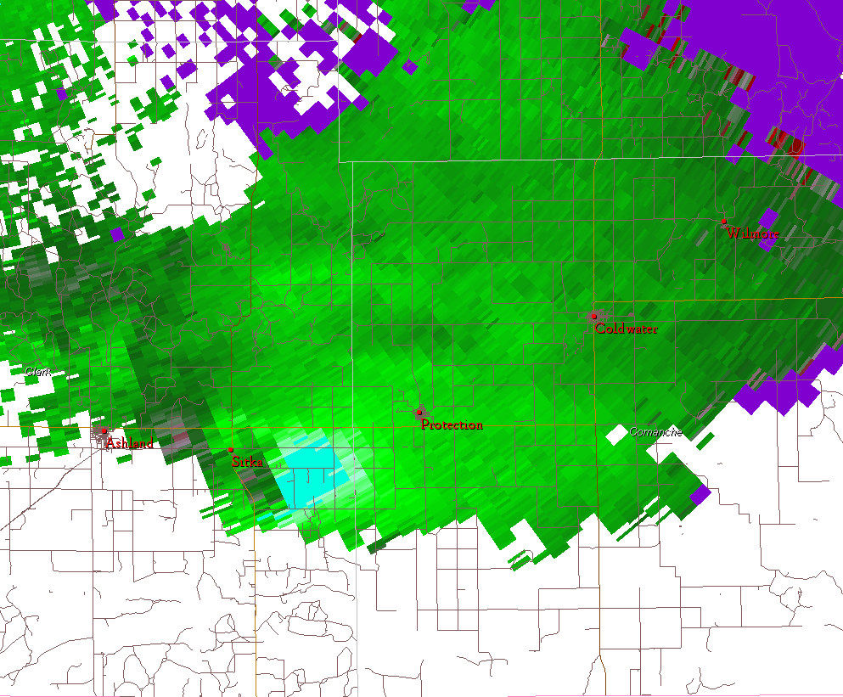
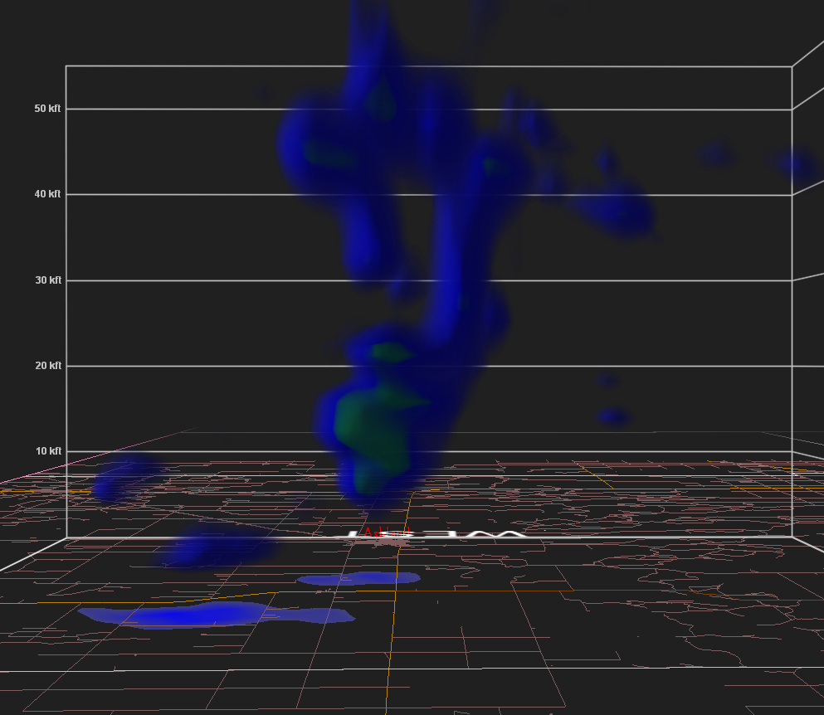
8p
9
10
11
12a
1
2
CDT
8:29pm
photographer

Slide 26
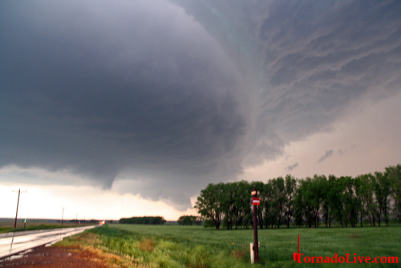
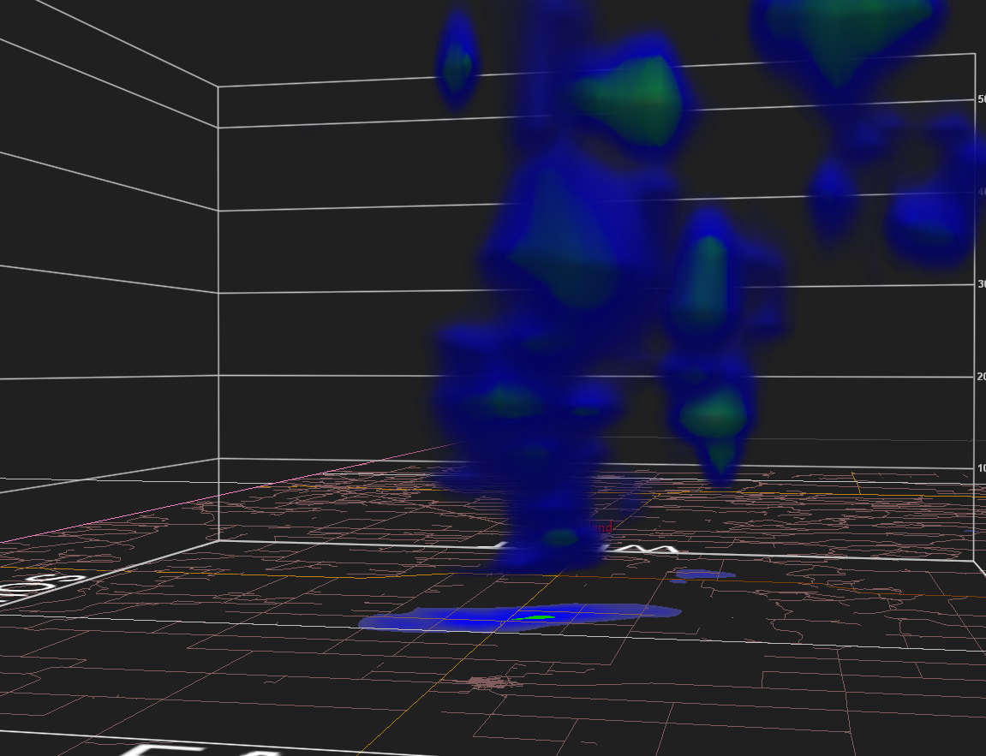
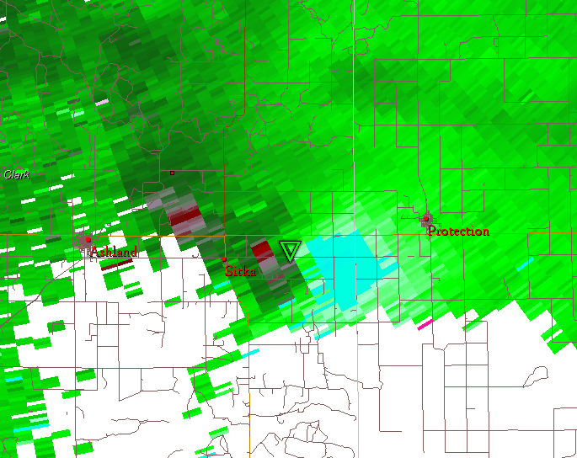
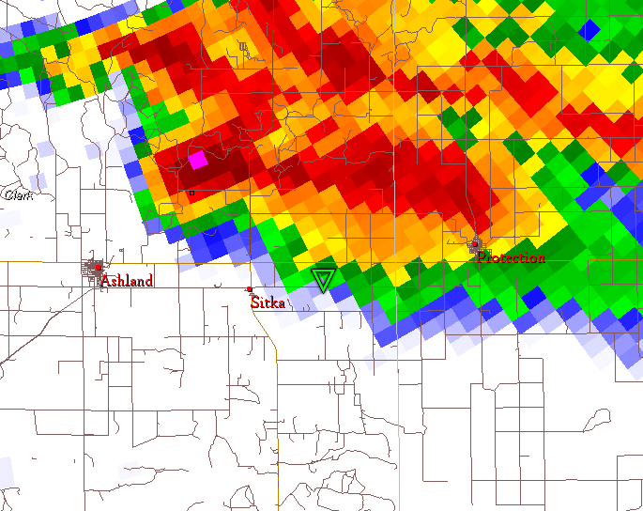
8p
9
10
11
12a
1
2
CDT
8:34pm
photographer

Slide 27
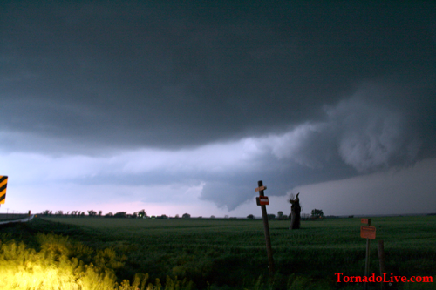
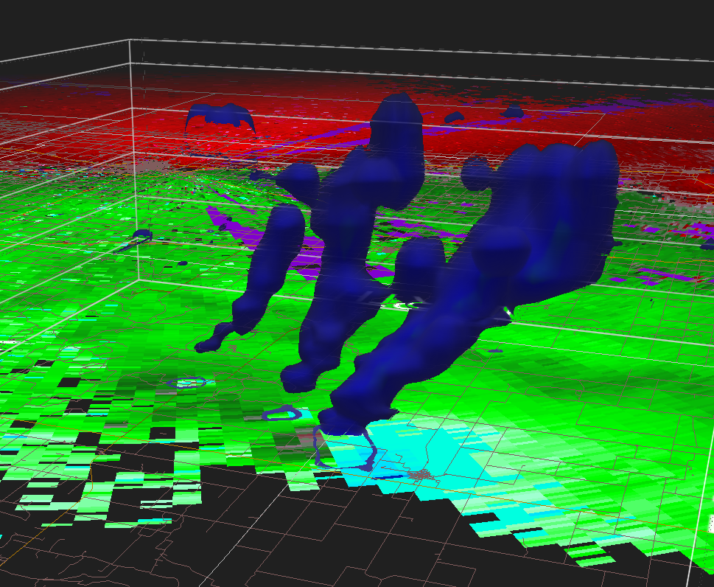
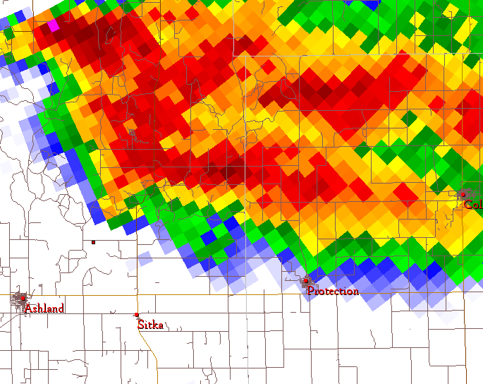
8p
9
10
11
12a
1
2
CDT
8:38pm
8:38pm
photographer

Slide 28
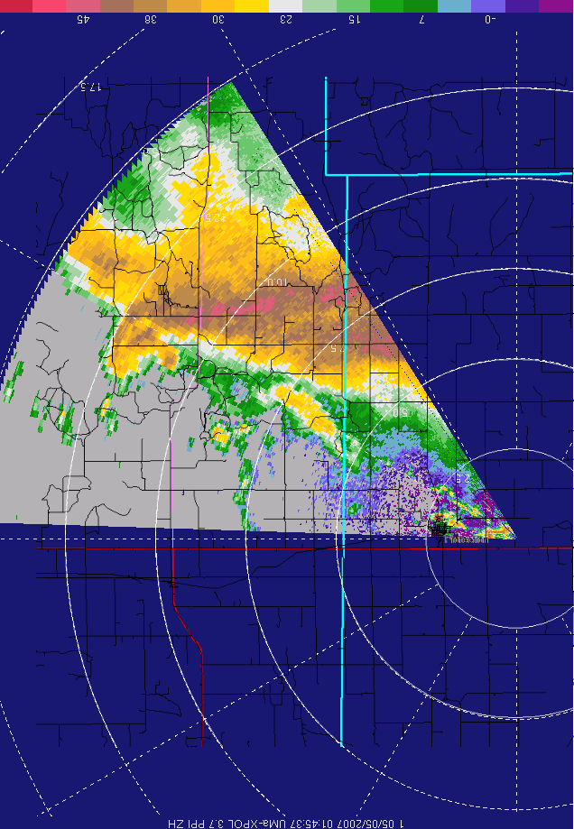
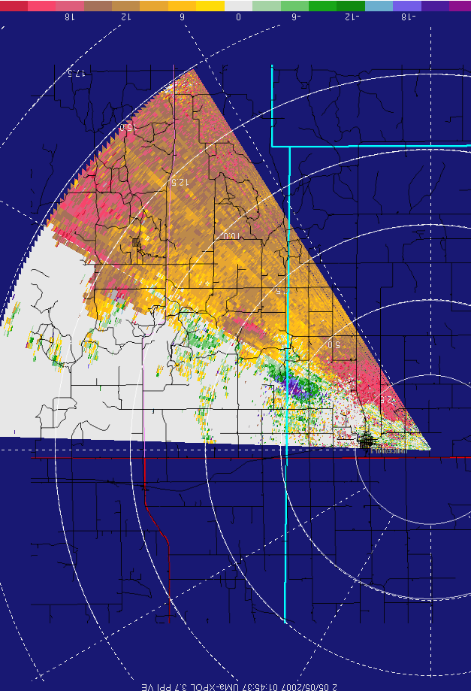
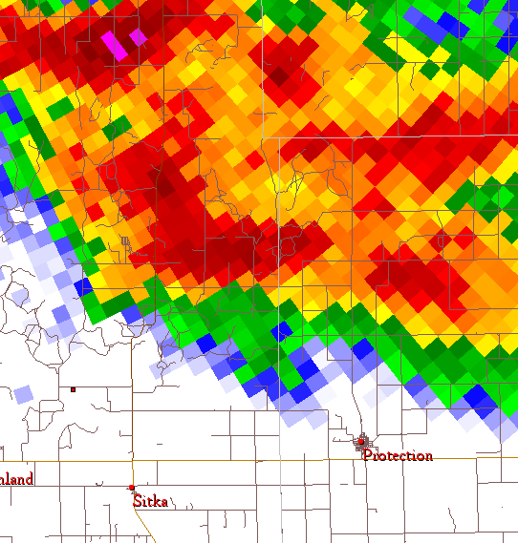

8p
9
10
11
12a
1
2
CDT
8:45pm

Slide 29





8p
9
10
11
12a
1
2
CDT
8:56pm
account quote
from Dick McGowan

Slide 30
8p
9
10
11
12a
1
2
CDT
And now, the atmosphere convulses
for the next 3 hours in an unprecedented
and tragic fashion. . .

Slide 31





8p
9
10
11
12a
1
2
CDT
9:11pm
9:12pm
9:12pm
photographer

Slide 32



8p
9
10
11
12a
1
2
CDT
9:19pm
1st call made to Kiowa Co. @ 9:18

Slide 33



8p
9
10
11
12a
1
2
CDT
45 dBZ isosurface
BWER
9:20pm
vortex hole?
9:21pm

Slide 34

8p
9
10
11
12a
1
2
CDT
9:21pm

Slide 35

8p
9
10
11
12a
1
2
CDT
9:23pm

Slide 36





8p
9
10
11
12a
1
2
CDT
9:26pm

Slide 37



8p
9
10
11
12a
1
2
CDT
~9:28pm

Slide 38



8p
9
10
11
12a
1
2
CDT
2.4 nm
96 kts
2nd call made to Kiowa Co. @ 9:28
9:29pm

Slide 39



8p
9
10
11
12a
1
2
CDT
9:32pm
Giant vortex crossing US-183

Slide 40


8p
9
10
11
12a
1
2
CDT
9:36pm
3rd and final call made to Kiowa Co. @ 9:37
110 kt inbound
74 kt outbound

Slide 41



8p
9
10
11
12a
1
2
CDT
55 kt inbound/outbound isosurface
9:41pm
Excellent media dissemination of urgent situation

Slide 42



8p
9
10
11
12a
1
2
CDT
Megan’s Story
9:47pm
“I was watching the weather and Dave Freeman said it was going to hit
Greensburg at 9:52pm – well we have 5 minutes if he is right. Then the hail
Got real big… they were probably golfball or a little larger”
1.3°, vortex hole resolved?
9:47:31pm
GHS

Slide 43

8p
9
10
11
12a
1
2
CDT
Megan’s Story
9:49pm
“Sirens still sounding, I looked at my phone and it said 9:49pm, so
I got down by the couch and grabbed a blanket. The wind picked up
Furiously. The power goes out.”

Slide 44


8p
9
10
11
12a
1
2
CDT
Megan’s Story
“I sat down facing the couch getting ready to crouch down,
When all of a sudden, my ears started to pop really bad. I mean
This was worse than going in a plane or diving deep under water.
This just hurt. It was probably one of the worst feelings I have ever
felt. Then my parents and the neighbor’s family said the same thing.”
~9:49:50 pm

Slide 45
8p
9
10
11
12a
1
2
CDT
Megan’s Story
~9:50:45
“The wind and sirens were still going… then it seemed like
It got deathly silent. I bet if someone dropped a pen on the
Ground you would be able to hear it a mile away. I mean this
Was freaky.”
~9:51:00
“…I tried to reach and get my lock box, but as I stuck my hand
Out, the windows exploded! They shattered into a million pieces.
I didn’t see it, but hearing it was enough.”
15-20s later
~9:51:15
“…I heard the walls tearing off and ripping into pieces. Something
Fell on my left shoulder and I had my head covered with my hands.
The sound was like a jet engine going right over us,
About to take off.”
just seconds later
9:54:00
Wind still overpowering
9:53:00
Still going, horrible roar, screaming
9:55:00
Comes to an end, rain

Slide 46

8p
9
10
11
12a
1
2
CDT
9:50:21 pm
9:54:13 pm
Max inbound: 102 kts
Max outboud: 77 kts
Rot Velocity: 90 kts
Max inbound: 126 kts
Max outboud: 104 kts
Rot Velocity: 115 kts

Slide 47


8p
9
10
11
12a
1
2
CDT
cycle #5 “Trousdale”
.052 s⁻¹ (187 hr⁻¹) delta-V = 224 kts
-105 kt
8.7 km
2.2 km
+119 kt
10:23 pm
33m after Greensburg hit
0.5° (2900 ft arl)

Slide 48


8p
9
10
11
12a
1
2
CDT
11:04pm
photographer

Slide 49

Tornado Tracks
May 4
source:
Storm Data

Slide 50

Tornado Tracks
May 5
source:
Storm Data

Slide 51

Tornado Tracks
May 4 & 5
source:
Storm Data

Slide 52



What If?
May 4, 2007 “Big 4” Tracks Over DFW Metroplex (& Moore, OK Comparison)
McKinney
Allen
Shepton
Plano
Addison
Irving
Ft. Worth
Dallas
Grand Prairie
courtesy North Central
Texas Council
Of Governments
Arlington
Burleson

Slide 53
Some Final Thoughts
Integrated warning system saved lives
  NWS radar operator on duty most “visible”, nationally, hence the positive recognition (when things go good!), and bad press when things go bad
  Strong relationship with broadcast media
    Timely issuance NWS products (SVS, LSR, etc)
      Increases their confidence in expressing sense of urgency
    Incredibly important partnership
      Sharing of information/reports -> timely, accurate dissemination of message
  Strong relationship with county EMs
    County spotter network providing communication to emergency management center/dispatch
  Strong relationship with storm chasing community
    While NWS doesn’t promote/encourage storm chasing, it is embraced at NWS DDC as a vital source for real-time information. NWS DDC is one of the top storm chasing territories in the country (especially May and June). Stormtrack.org, Spotternetwork.org, etc.
  Working with great colleagues makes operations so much easier
    May 4 (Ray Burgert, Matt Gerard, Jennifer Ritterling, Jonathan Finch, Mike Bell)
    This also includes surrounding WFOs (interoffice collaboration)

Slide 54
Thanks
The following individuals contributed material and/or information for this talk (in no particular order!):
  Jana Houser, Robin Tanamachi, Howie Bluestein (X-band mobile radar data)
  Megan, Greensburg H.S. student (personal account)
  Jeff Hutton (detailed shape file tornado tracks)
  Darin Brunin & Dick McGowan (photos, chase account)
  Van De Wald (photo)
  Rick Schmidt (photos, video stills)
  Steve Bluford & Joel Genung (video stills, chase account)
  Martin Kucera (title photo)
  Mike Scantlin (photos)
  Jim LaDue (video stills)
  Lance Ferguson (chase account)
  Shane Adams (video still)
  and Les Lemon (collaborator)

Slide 55

The End

