Slide 1
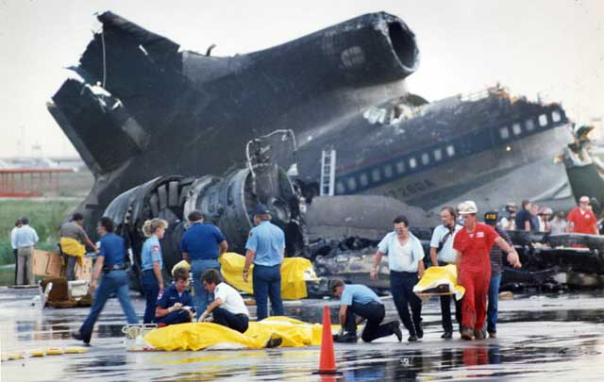
Turbulence and local winds
Notes:
This was a delta airlines jumbo jet at DFW… we’ll get to that later

Slide 2
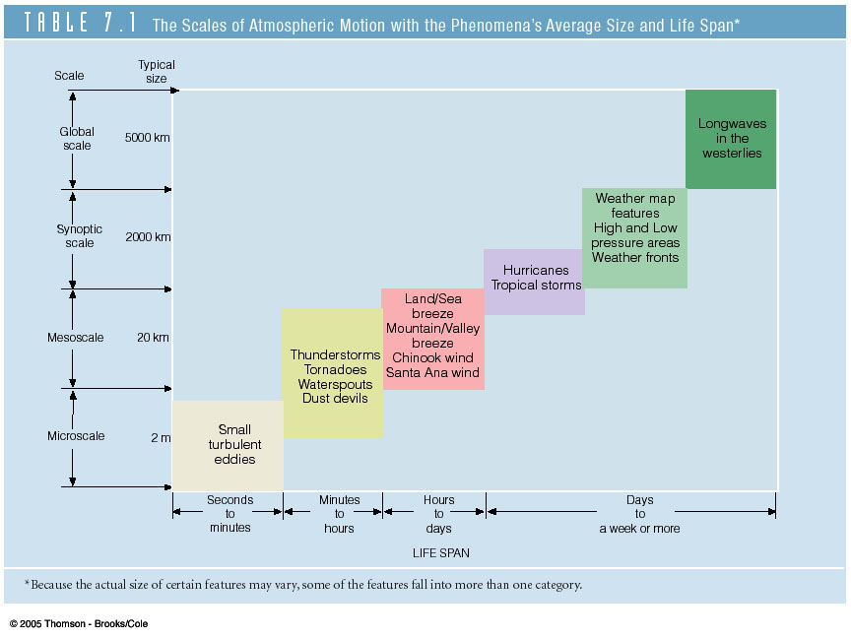
Scales of Atmospheric Motion vs. Lifespan
The general circulation
Atmospheric oscillations
We’ve already started to investigate some of the synoptic-scale features…
Topics for today’s discussion
Basically here’s our roadmap for the rest of the course.

Slide 3
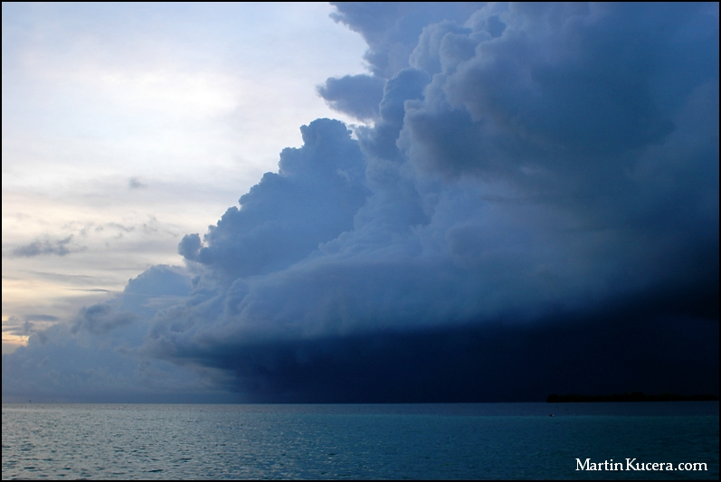
The smallest type of atmospheric motion is turbulence… it is defined as small scale changes in wind speed or direction(wind shear)
It is chaotic, changes rapidly, and occurs over small distances
This makes it hard to predict…
…although we cannot predict individual gusts or eddies, we can identify some locations where turbulence usually occurs

Slide 4

“From the flight deck… please return to your seats and fasten your seatbelts, there is a bit of weather ahead and we might get a couple bumps…”

Slide 5
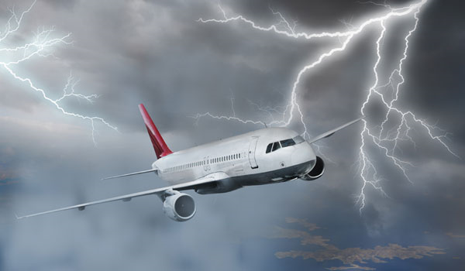

Slide 6
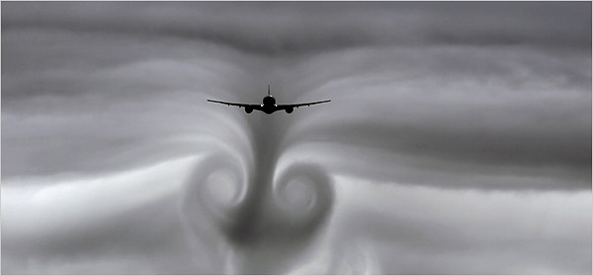
Typical types of turbulence
Mechanical
Mountain waves
Convection
Air mass boundaries(some fronts, jet stream)
Notes:
Large aircraft can also create significant turbulence

Slide 7
Mechanical Turbulence
Occurs near the surface
Caused by friction, and obstructions to wind flow
Obstacles include trees, buildings, and terrain.
The stronger the wind or the larger obstruction, the stronger the turbulence

Slide 8
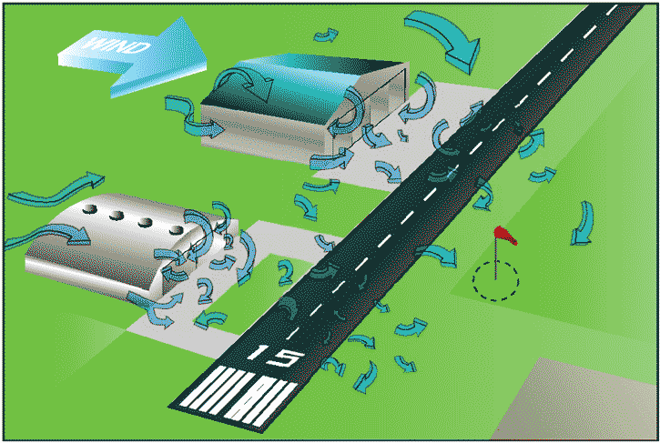

Slide 9
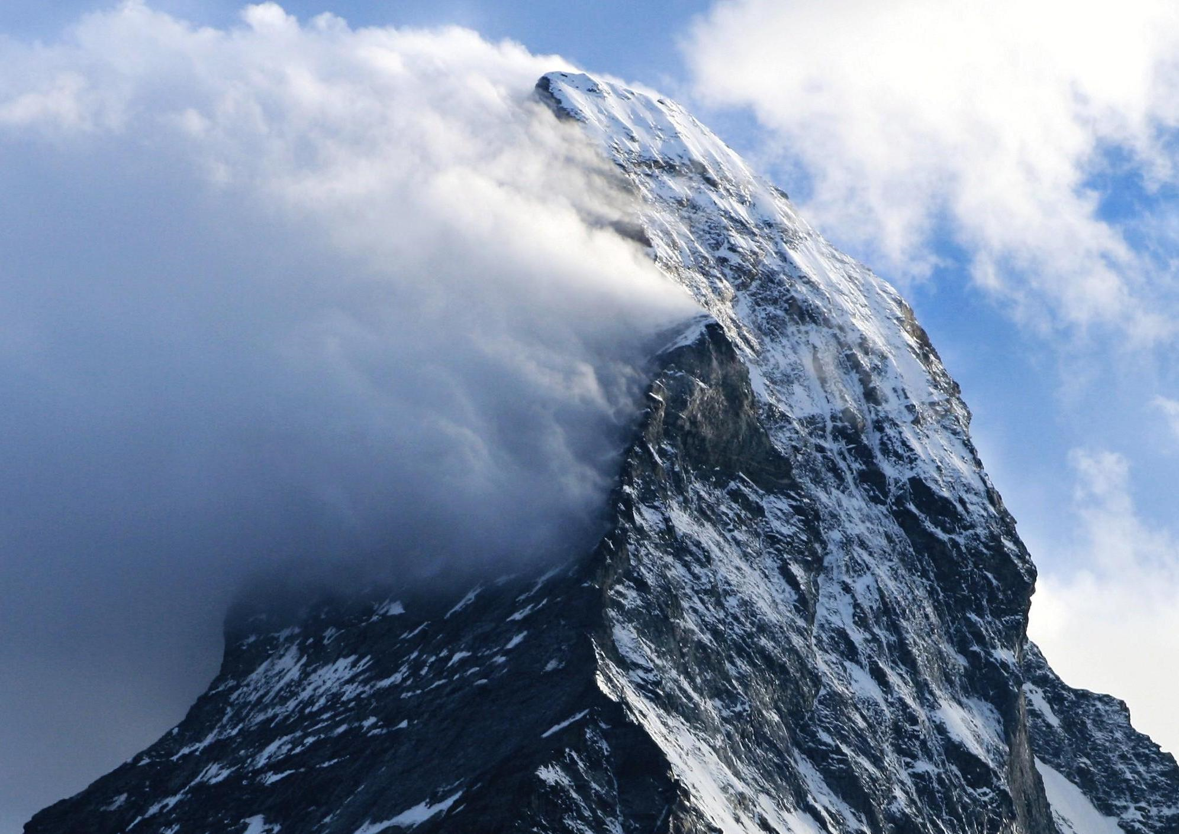
Add a really
large obstacle….

Slide 10
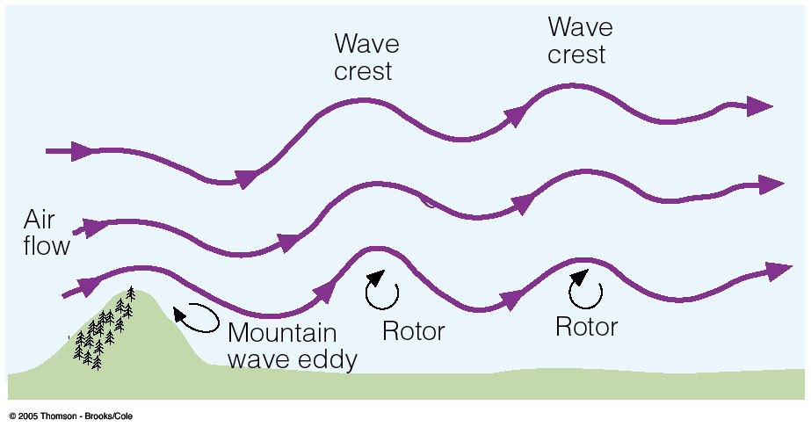


Mountain wave turbulence
Mountain wave turbulence is amongst the strongest on earth
Notes:
Not only are the obstacles larger, but winds are stronger at higher altitudes. Rotors and waves downstream = extreme, on good day max g’s easily exceeded

Slide 11
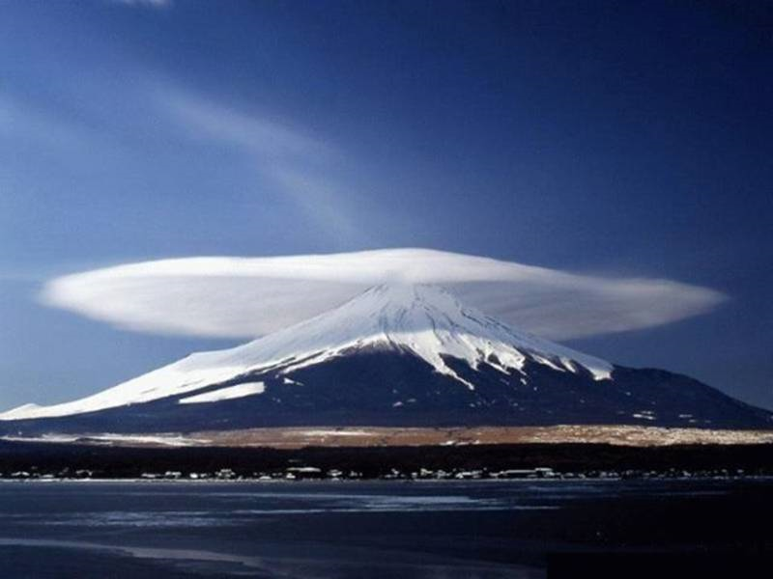

Slide 12
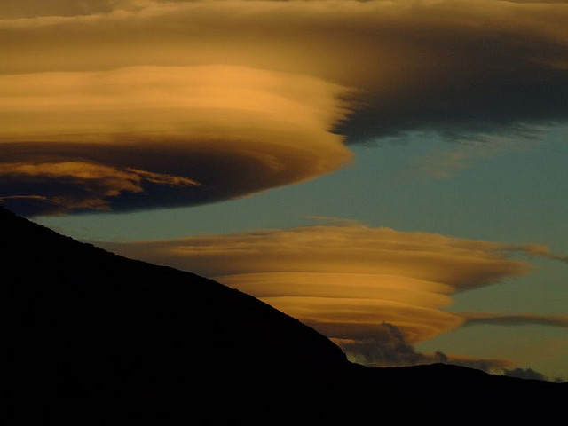

Slide 13
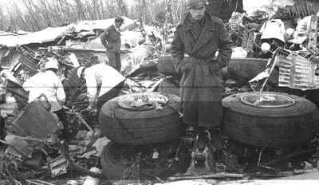
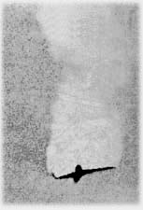
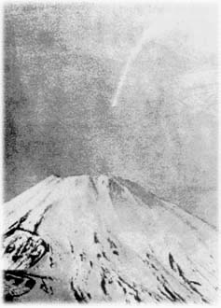
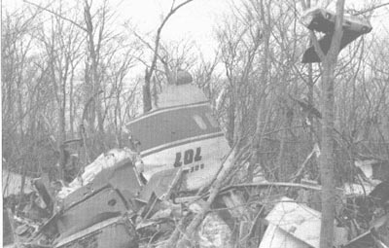
British Overseas Airways Flight 911, departing Tokyo, March 5 1966
Notes:
Climbing out of RJTT… 60-70knots over the summit of fuji… high Tdd, no clouds for warning signs… USN aircraft registers 9gs during search… 707 typical transport 3.8gs structural max. Tail ripped off… no chance

Slide 14
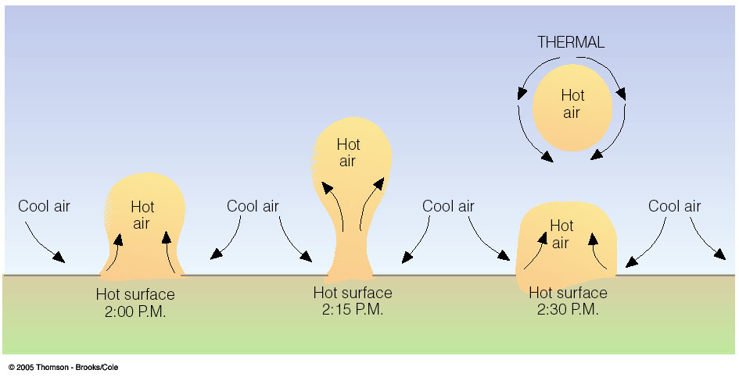
Thermal Turbulence
(Free Convection)
Formed by rising thermals due to surface heating during the day. These may form convective clouds by afternoon.
So if you want the smoothest ride, take the morning flight!
Notes:
Updrafts and downdrafts near eachother

Slide 15
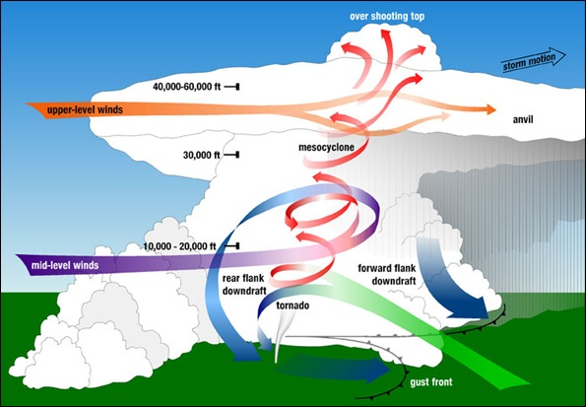
Plenty of turbulence here
Notes:
Talk about winds varying speed and direction, especially proximity of powerful updrafts and downdrafts

Slide 16
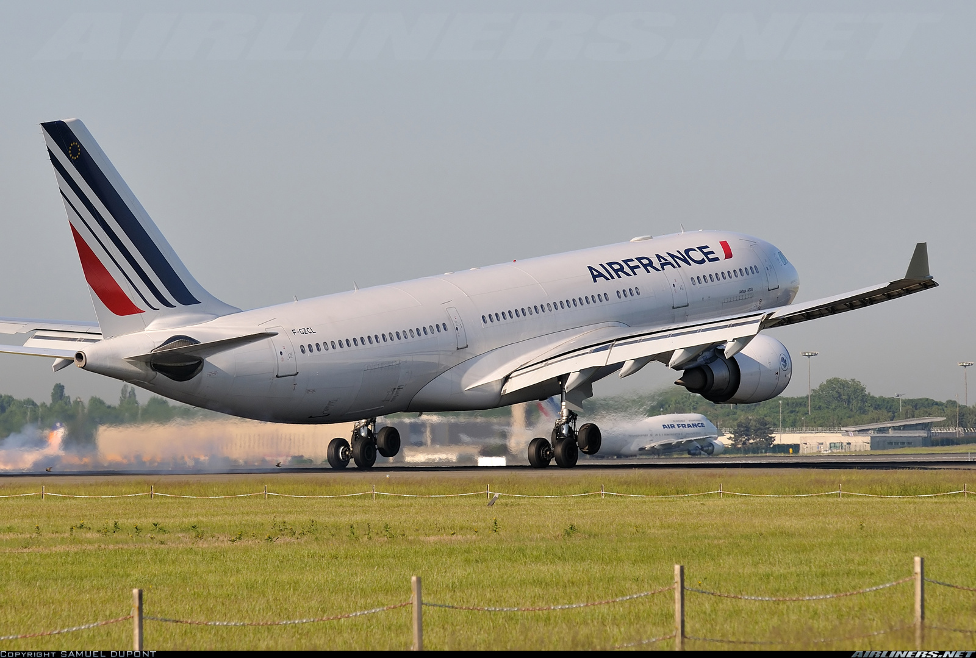
Air France 447, June 1 2009
In the early morning hours of June 1 2009, Air France maintenance computers began recording a series of automated text messages from one of their aircraft on a nightly flight across the Atlantic between Rio de Janeiro and Paris.
Lasting 4 minutes, the text messages indicated a host of system failures...
After these messages ceased, no further contact with the aircraft was ever made.
Notes:
A330 with about 230 pax, 11+ hour flight,

Slide 17
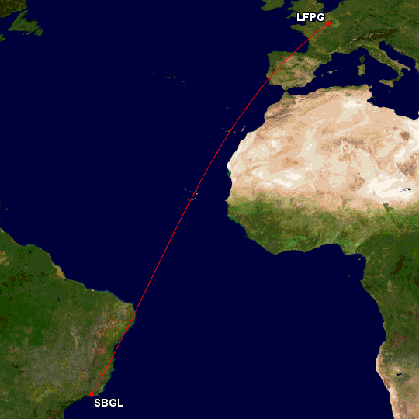
This is the most direct route between Rio and Paris. The actual route of flight would be very close to this.
Notes:
Ask why it is curved

Slide 18
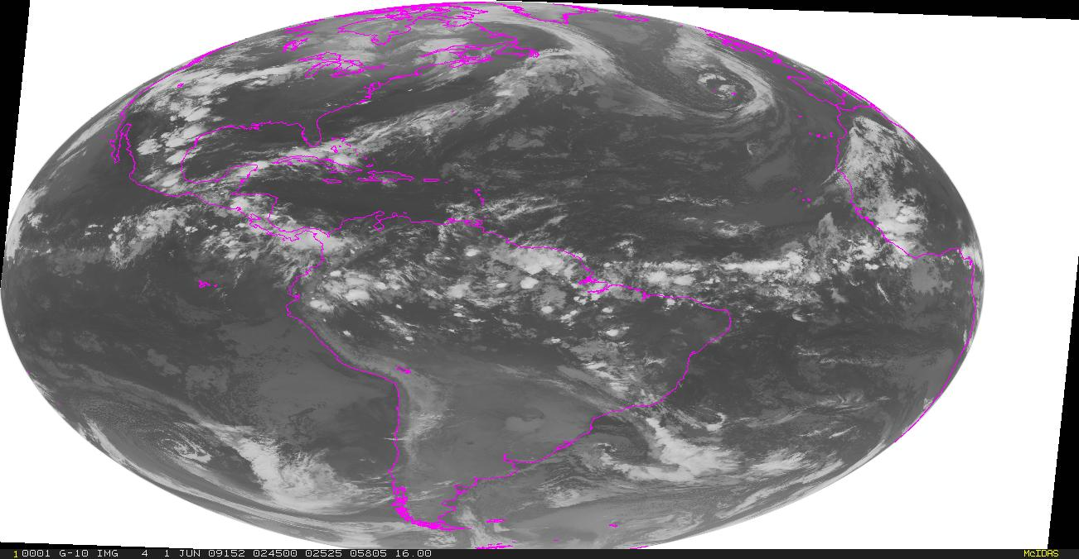
Notes:
Now lets overview estimated route of flight

Slide 19
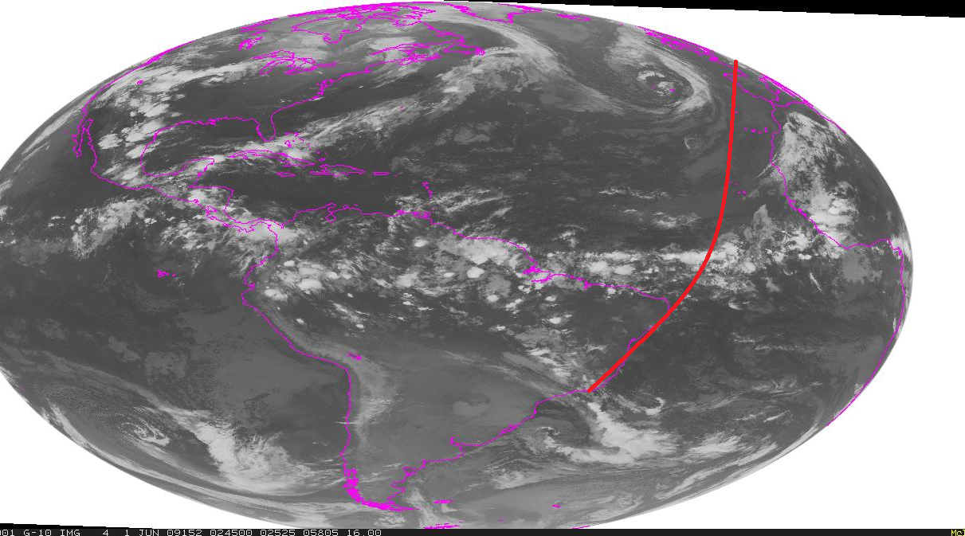
Notes:
Acars messages eventually confirm location

Slide 20
Autopilot disengage
Autothrust disengage
Flight control computers – multiple failures – resorting to alternate profile
Rudder limiter fault
TCAS fault
Flight envelope warning
Guidance 1 fault
Guidance 2 fault
Guidance 3 fault
Standby instruments 1 fault
Standby instruments 2 fault
air data computer fail
Remaining air data computers disagree
Flight management computers fault
Primary flight display fault
Secondary flight display fault
Cabin Depressurizing
>End of messages<
While the official investigation is ongoing, it is fairly clear that the scope of system failures indicates that following some initial shock, the aircraft is unable to be flown. Pieces of flight controls, possibly large sections of the plane, have likely detached. The final message probably indicates the fuselage is breaking up, or perhaps it is the last gasp of the failing computer systems.
Notes:
Notes
AFR1: The plane misses its next scheduled ATC call. This is fairly routine... usually the plane is on the wrong frequency... so ATC calls up Air France operations, and they call the planes Satphone.
Cockpit sat phones are pretty awesome... they always work They don't drop calls. I used at my last job quite a bit, I never heard of a plane failing to respond to a satphone.
So when AFR447 fails to respond to ATC and the sat phone... that is not routine... people get worried. There is no radar coverage over the middle of the ocean, and the plane has not shown up at any of the possible diversion airports along the coast of Brazil or Africa, nor on any ATC radar along the coasts. AFR ops can do nothing but keep calling and wait. In the meantime, lets check the route of flight for weather... see if that could be causing a problem.
AFR2: This is the great circle route between Rio and Paris, which is the most direct route between two points on the earth. On this picture it appears curved in this image because this is a 2d projection of the 3d world. The circle represents the rough position of the aircraft when the ACARS mx reports occured.
AFR3: This is an infrared satellite image at about the same time the aircraft went missing. It is taken by a US satellite in geostationary orbit. Infrared can be used to show the temperature of cloud tops, and by comparing them to model data we can estimate the height of the the thunderstorms in the ITCZ. The whitest tops are the coldest and therefore highest.
Tops are at ~55,000(tim vasquez). AFR447 is at 35,000.
AFR4:
Now overlayed is the flight path. Again it is curved because of the map projection, coverting the 3d world to this image
They fly through a large line of thunderstorms. The crew would have been using their onboard radar to find a safer route through as they approach, it is not known if they failed in this and entered one of the larger cells and extreme turbulence, or if more normal moderate or severe turbulence combined with improper crew or autoflight response to overstress the airframe.
Read mx messages
AFR5: It is soon clear that the aircraft is down in the atlantic. The hudson crash is not representative of aircraft ditchings. You don't get to go down in the middle of a line of thunderstorms hundreds of miles offshore and live. It just doesnt happen. Final confirmation occurs when the aircrafts scheduled arrival time comes and goes. The aircraft obviously does not appear at de gaule
A few remnants of AFR447 remain floating, and over the next week are found by ships of the french and brazilian navies. The black boxes are not recovered. There are no witnesses. There are no survivors. All we have is that satellite picture. Given the location(equatorial) hail was not a factor. Icing was not a factor at that altitude. It is not likely that ligntning could bring down that plane. Despite relying entirely on its computers, they are hardened against EM shock or surge. The conclusion is that strong turbulence contributed in large part, again perhaps with pilot or autoflight error, to bring down the plane.

Slide 21
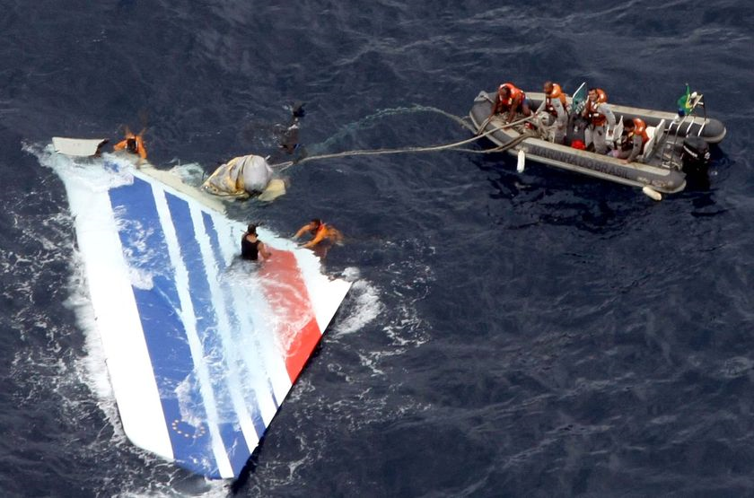
Notes:
Brazilian navy… marine nationale… search for weeks… black boxes deep down… still searching… high pressure salt water?

Slide 22
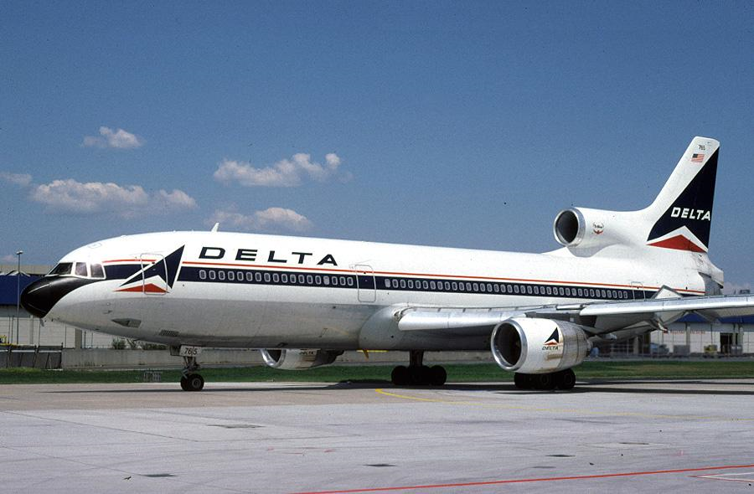
Delta 191, DFW, August 2 1985
Notes:
Play video… captain recognizes threat… 72 knots of shear(ntsb)… Vref(+10?)=140… Vso=120 = dead… copilot “right ahead of us”

Slide 23
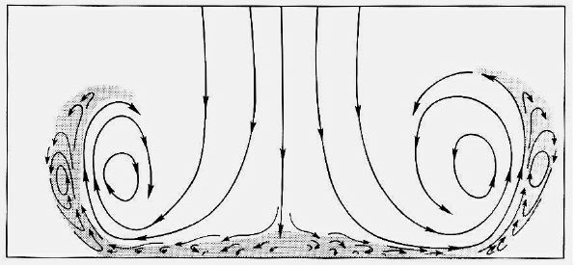

Typical microburst
Airport
Notes:
Glidescope… pilot attempting to fly this… headwind, shear to tailwind… ~180mph… cover distance in ~20 seconds… dirty aircraft slow to climb, large jet engines slow to spool up… too late

Slide 24
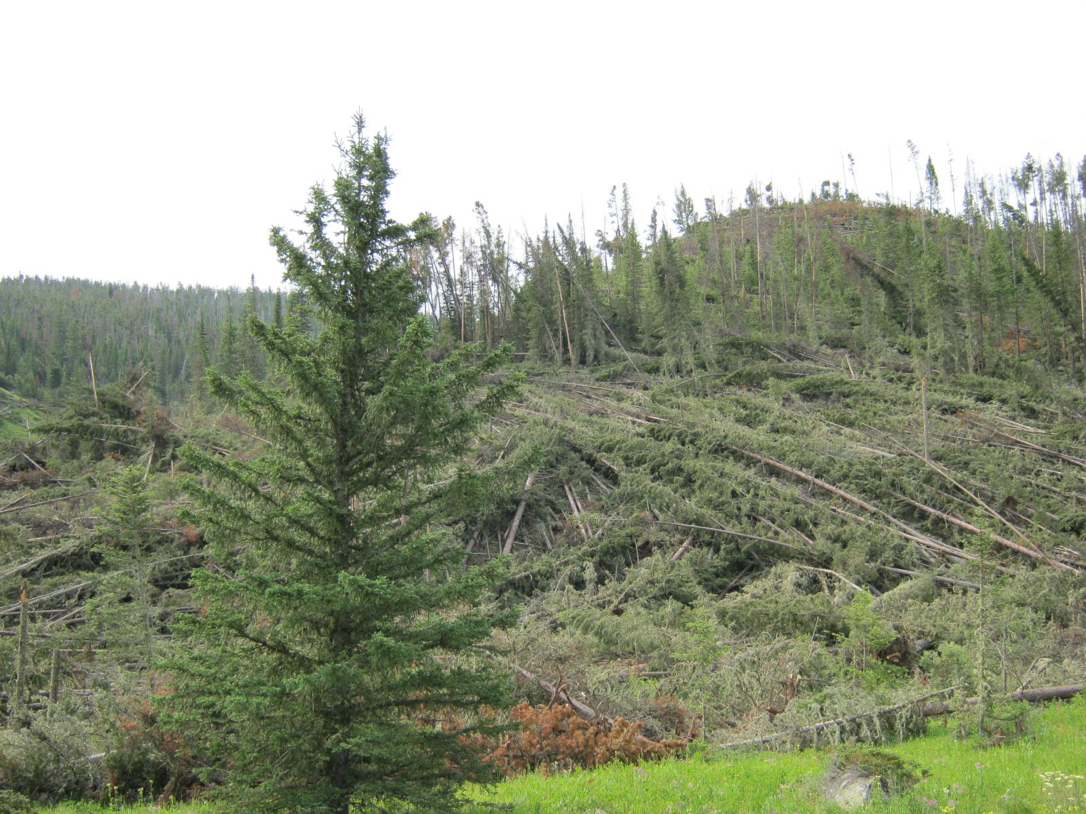
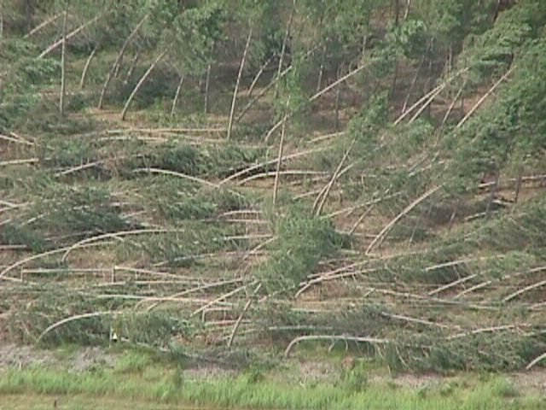
Notes:
Delete maybe?

Slide 25
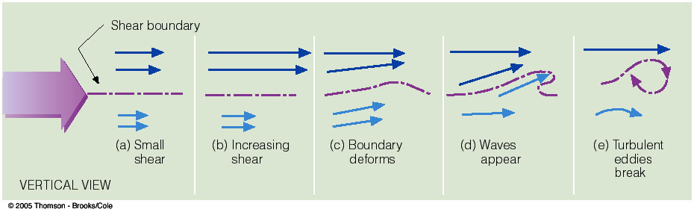

Wind shear creating turbulent eddies
Sample jet stream…
150mb
250mb
350mb
450mb
75 knots
130 knots
100 knots
80 knots
“Man its too bumpy up here to take a nap, call up Denver center and see if the ride gets smoother ahead…”
“Ya, but check out this tailwind”
Notes:
…typical pilots…

Slide 26
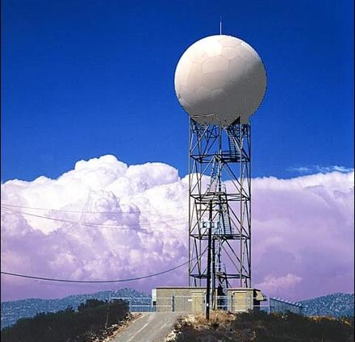
Turbulence Detection
Notes:
Radar(land and airborne) sees tstorms… better forecasts… better knowledge… LLWAS… TDWR… PIREPs

Slide 27
Local Winds:
Sea-Land Breeze
Mountain-Valley Circulation
Basically the same physical idea for each one:
A direct thermal circulation which occurs a small enough scale that the pressure gradient is the dominant force which drives the wind.
Driven by the diurnal cycle of solar heating.

Slide 28
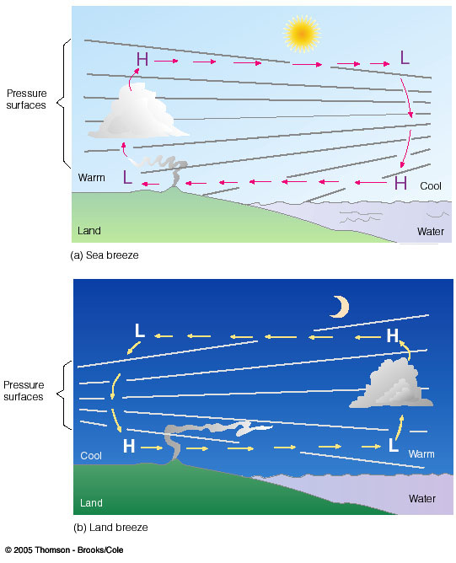
Sea-Land Breeze
DAYTIME
NIGHTIME
PGF
PGF
Water is relatively cool
Land is relatively warm
Onshore flow at the surface
Offshore flow aloft.
Water is relatively warm
Land is relatively cool
Offshore flow at the surface
Onshore flow aloft.
Occurs because water has a high heat capacity, so it heats and cools more slowly than the land.

Slide 29
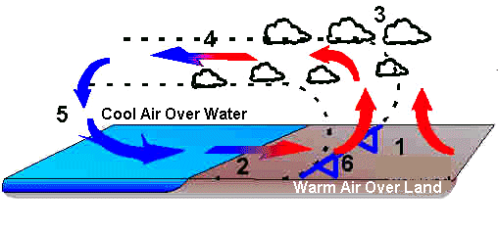
Sea Breeze Circulation and
Sea Breeze Front
Sea breeze forces air to converge over land, leading to upward motion and formation of clouds and storms.

Slide 30
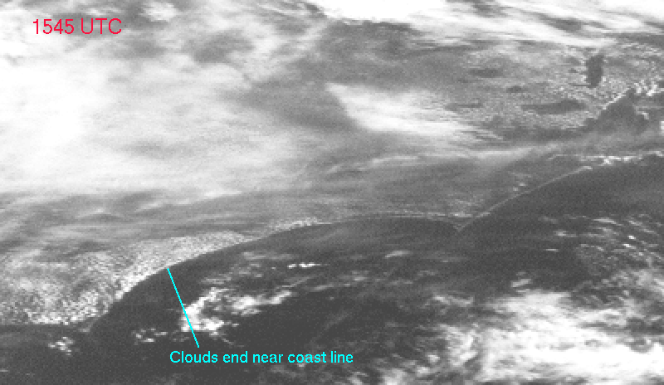
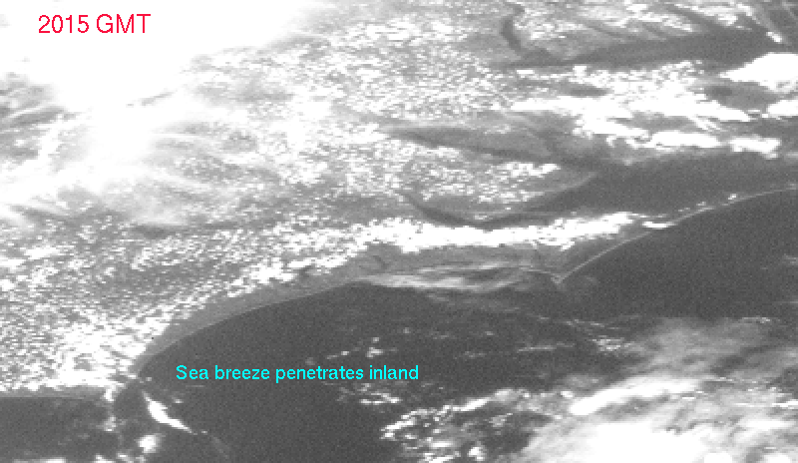
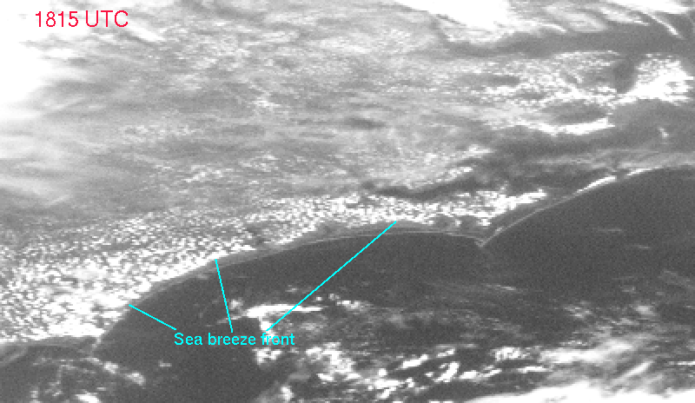
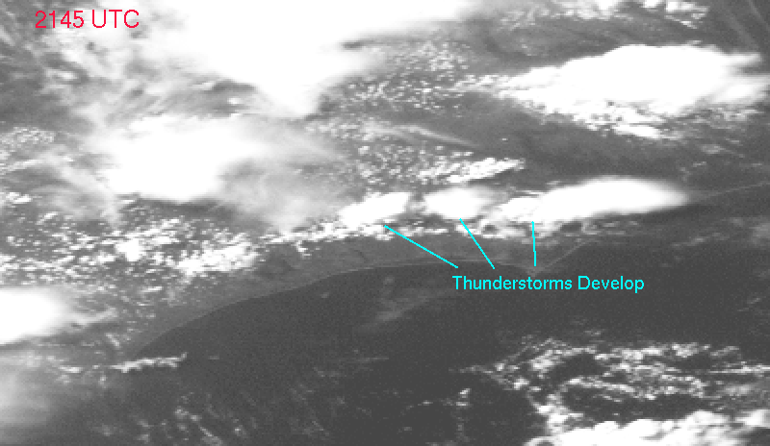
Sea Breeze Front: North Carolina Example
EARLY MORNING
MID AFTERNOON
MID MORNING
LATE AFTERNOON
(University of Wisconsin)

Slide 31
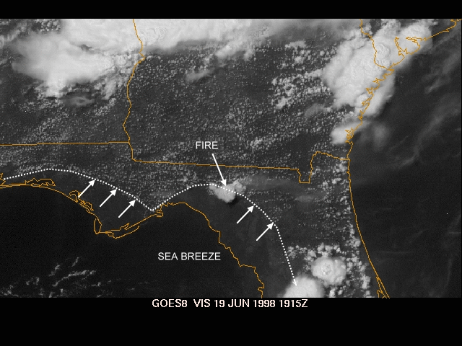
Florida Peninsula
Sea breeze is blowing the smoke from a forest file away from the Gulf of Mexico side (FL Dept. of Forestry).

Slide 32
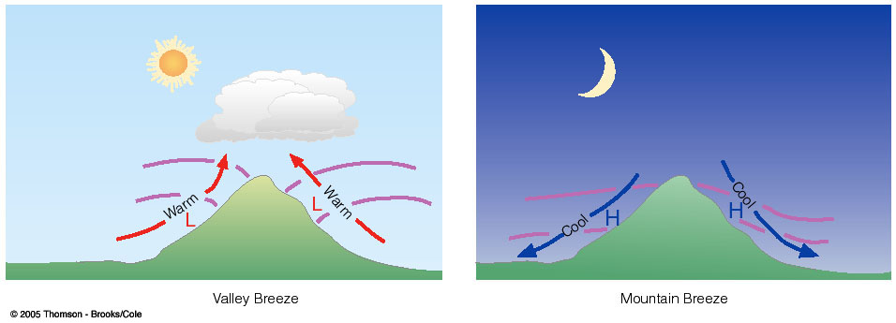
Mountain-Valley Winds
DAYTIME
NIGHTTIME
Air is heated along mountain slopes
Warmed air is locally less dense than the surrounding air above the valley.
Upslope flow.
Air is cooled along mountain slopes
Cooled air is locally more dense than the surrounding air above the valley.
Downslope flow.

Slide 33
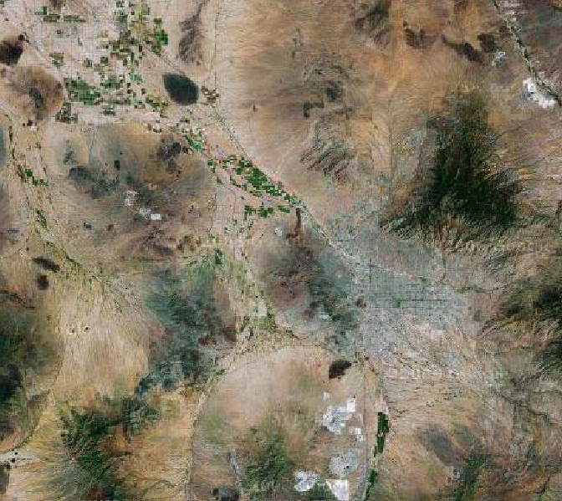
Local Topography of Tucson, AZ
CATALINA MTNS.
We’re surrounded by mountains on three sides, so mountain valley circulations play a BIG role in our weather—especially during the monsoon!
TUCSON MTNS.
X
University
of AZ
RINCON MTNS.

